Slide 1
The CARES Toolkit
End-of-Life Cases and Resources:
An Interprofessional Toolkit for Health Science Students
Case Name: 30-Year-Old White Man Living with ALS
College:
Course:
Instructor:

Slide 2
Learning Topics
1. Insurance issues (uninsured, self-pay)
2. Interprofessional approach to care for patient with severe chronic illness and at end-of-life
3. End-of-life resources/support for family

Slide 3
Specific Communication / Conversation Skills
1. Know how to conduct challenging conversations with patients, families including how to discuss risk/benefits of interventions
2. Know how to assess patient’s goals of care, preferences and values
3. Know how to discuss with patient/families community-based resources and services
4. Know how to communicate and collaborate with interprofessional teams to provide care for patients/ families.

Slide 4
Interprofessional Team Members
Team Members / Role:
The group practice includes physicians, nurse practitioners, nurses, medical assistants and administrator.

Slide 5
Case Summary
Setting of Encounter: After hours call to group practice
Context / Reason for Encounter: You are taking after hours call for your group practice. You receive a call from Carol, who identifies herself as a nurse and girlfriend of Dr. Stephen Jones. She explains that she lives with and takes care of him. You know Stephen - he is a recent graduate from the family medicine program where you are a faculty member. You had heard he was diagnosed with Amyotrophic Lateral Sclerosis (ALS) shortly after finishing his residency program. Carol is crying - their usual doctor is out of the country. “His doc makes home visits and takes care of Stephen” she explains. “We ran out of morphine for Stephen yesterday. Today he’s really, really in a lot of pain.” You decide to make a home visit; he lives a few blocks from you.

Slide 6
Demographics
Gender: Male (he, him)
Age: 30-years-old
Ethnicity: White
Living Situation: Stephen lives with his partner, Carol; owns house.
Occupation: Physician, self-employed, not currently working. Stephen moonlighted during residency on free weekends providing substitute coverage (locum tenens) that paid $200 per hour but provided no health benefits. He continued this work after finishing his residency. At the time of his ALS diagnosis six months ago he was self-employed.
Insurance Coverage: Uninsured, self-pay

Slide 7
Demographics
Family / Caregiver Issues: Stephen's partner, Carol, took family medical leave from her job as an ER nurse to take care of him.
Social Economic Status:
Social Determinants of Health:
Social / Mental Health Wellbeing:
Religious / Spiritual Considerations:
Cultural Beliefs / Perspectives:

Slide 8
Patient Health Information
History of Present Illness: Dr. Jones is a 30-year-old male with severe (8 out of 10) pain increasing over the last 24 hours. He was diagnosed with Amyotrophic Lateral Sclerosis (ALS) six months ago, shortly after finishing his residency program. His course has been rapidly progressive, and he is now very emaciated and weak, limited to his bed. Steven says he is very anxious – partially because of the severe pain, but he also worries about his debts - his $250,000 in student loans and $300,000 house mortgage. He has no way to pay off his debt now. Carol says that over the past few weeks Stephen is not interested in food and is able to take only small sips of juice and water due to difficulty in swallowing. He is no longer able to carry on daily living activities – he cannot feed himself, ambulate or use his arms or legs.
Illness Course / Treatment Information: not apply

Slide 9
Patient Health Information
Physical Exam:
Vital Signs: Ht: 6ft 2in; Wt: 135 lbs; Pulse: 92; BP: 90/64; Respiratory Rate 18
General: Emaciated male, lying immobile in a hospital bed in his living room. He immediately recognizes you and smiles. He answers questions in a barely audible whisper, and nods or shakes his head for yes/no answers. He winces in pain as you gently examine him.
Neurologic: Alert, oriented to person, place and time. His reflexes are brisk, with several beats of clonus in his upper extremities. He has a Babinski sign on the right foot, and a Hoffman’s sign in his right thumb and index finger.
Musculoskeletal: Upper and lower extremity muscles are atrophied throughout. He has muscle fasciculations in his thighs and calves.
Skin: There are no decubitus ulcers nor evidence of skin breakdown.
Lungs: Shallow respirations
Heart: Tachycardia at 92, no murmurs
Abdomen: Bowel sounds are present. No masses.
Genital: Foley catheter in place, dark colored urine is trickling slowly into the bag.
Rectal: Declined. The stool in hemoccult negative.

Slide 10
Patient Health Information
Medications / Treatments: Morphine sulfate liquid 10mg/ml every 8 hours as needed for pain.
Allergies / Intolerances: No allergies
Tobacco, Alcohol or Substance Use: Tobacco: none; alcohol: none.
Review of Systems:
Past Medical History: No significant past medical history
Family History: He has no children or siblings. No history of ALS in the family. His 58-year-old mother is healthy. His dad died of an acute myocardial infarction at age 62.

Slide 11
Health and Community Services
Identify any existing or needed health or community-based services:
Healthcare Services: Eligibility / Enrollment / Contact Information
Not receiving any services at this time
Uninsured, self-pay
Community Services: Eligibility / Enrollment / Contact Information
Not receiving any services at this time

Slide 12
Overall Assessment
Acute, severe pain in a patient with advanced ALS.

Slide 13
Advance Care Planning
Comfort measures.
Do not hospitalize, intubate, or place a feeding tube.
He wishes to die at home if possible.

Slide 14
Advance Care Planning
Advance Care Planning
What matters most to the patient now?
He is in severe pain and wants relief as soon as possible.
What do they want their health for?
Comfort measures only; wishes to die at home.

Slide 15
Next Steps / Outcomes
What happens next: 1. What health services might Dr. Jones be eligible for that he can receive at home?
2. What can be done to better control his pain and anxiety?
3. What health insurance coverage might Dr. Jones be eligible for in his current condition?
4. What more do you need to know about his current directives, or if he wishes to modify them?
5. What can be done about his financial situation – affordable care, medications, respite care, accrued student loan debt, mortgage? Who will assume his obligations?
6. What policy issues need attention in terms of health professions education costs?
Details about family conversations:
What happens at, or near, death of patient:
What support does family need before and after death of patient:

Slide 16
Challenging Conversations
Best Case / Worst Case:
Risk / Benefit of Intervention:

Slide 17
Interprofessional Focus
What role do other disciplines play in this patient’s end-of-life care?
Who can help you provide the best care and honor the patient’s wishes?

Slide 18
Interprofessional Focus
How will you approach utilizing a team approach to providing care?
Beyond referrals, how will you become comfortable with going outside your comfort zone?
Are there any integrative, traditional, or complementary therapies that will help the patient at this stage or later?

Slide 19
Questions to Consider
?
Can you identify any overarching bias?
Can you identify any possible assumptions one might make about this patient?
What information about this patient might inform public policy or regulatory action?

Slide 20
Teaching Points
Check boxes to indicate 3-5 teaching points:
x
ADVANCE CARE DIRECTIVE
Teaching point: Each health science student should be
knowledgeable about advance care directives; and
be able to communicate and engage patients / families in advance care planning across settings and across the lifespan.
x
PALLIATIVE CARE AND HOSPICE
Teaching point: Each health science student should be
knowledgeable about palliative care and hospice; and
be able to effectively communicate this information to patients / families.

Slide 21
Teaching Points
Teaching Points
Check boxes to indicate 3-5 teaching points:
x
CULTURAL HUMILITY
Teaching point: Each health science student should be
knowledgeable about cultural considerations in the care of patients and families, and
be able to effectively communicate with humility, curiosity, care, respect, and dignity.
x
COMMUNITY RESOURCES
Teaching point: Each health science student should be
knowledgeable about community resources to support serious illness and end-of-life care, and
be able to effectively connect patients/families with these resources.

Slide 22
Teaching Points
Check boxes to indicate 3-5 teaching points:
x
CHALLENGING CONVERSATIONS
Teaching point: Each health science student should be
knowledgeable about how to deliver “best case / worst case” and
be able to effectively conduct challenging conversations with patients / families (including how to discuss risk / benefits of interventions).
x
INTERPROFESSIONAL CARE
Teaching point: Each health science student should be
knowledgeable about the role of team members & benefits of team-based care and
be able to effectively work with team members in the care of patients / families with serious illness or at the end-of-life.

Slide 23
Resources
Home hospice (currently uninsured, self-pay)
Bereavement support for his wife
Advance care planning support

Slide 24
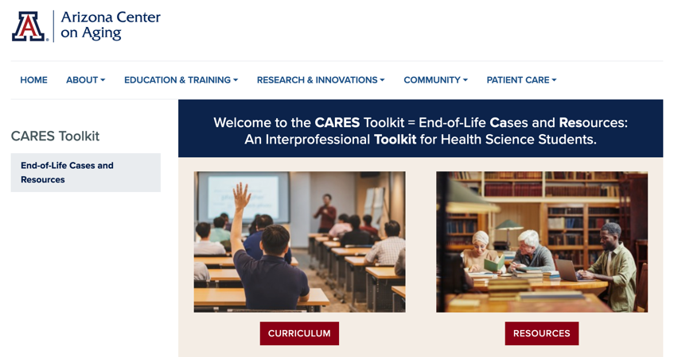
Thank
you
Please visit the Center on Aging
aging.arizona.edu
for more information on the CARES Toolkit
and other end-of-life resources
This project was funded by a grant from the David and Lura Lovell Foundation

