Slide 1
The CARES Toolkit
End-of-Life Cases and Resources:
An Interprofessional Toolkit for Health Science Students
Case Name: Latino Teenager Living with Bone Cancer
College:
Course:
Instructor:

Slide 2
Learning Topics
Ethics of difficult conversations
Language Barriers; Use of interpreters
Interprofessional approach to care for children / adolescents with severe chronic illness or at end-of-life
Treatment / decision making for children / adolescents
Immigration status
Access to health care for undocumented patients and family
Arizona Healthcare Coverage: limitations of emergency Arizona Health Care Cost Containment System (AHCCCS)
Family meetings

Slide 3
Learning Topics
Appropriate spiritual assessment and chaplains as members of the healthcare team especially when delivering bad news or conversations about end-of-life care
Difference in palliative care / hospice care for children and adolescents
Treatment preferences, complementary and alternative treatments for cancer, cultural aspects, and interaction with chemotherapy
Housing modifications: does living environment impact mobility (especially for cancer in leg)? Note: this can be an issue in rental properties

Slide 4
Specific Communication / Conversation Skills
1. Use of a translator/interpreter with child and parents
2. Conducting a family meeting with child and parents
3. Conducting a challenging conversation, involving delivering bad news
4. Identifying treatment preferences for cancer in a Latino teenager

Slide 5
Interprofessional Team Members
Team Members/Role:
Nursing -
Medicine -
Surgery -
Pharmacy -
Social Work -

Slide 6
Case Summary
Setting of Encounter: Clinica Amistad (free outpatient clinic)
Context / Reason for Encounter: Parents bring their son to clinic because of leg pain, unable to play soccer, hard to ambulate.
Encounter #1: Discuss initial diagnosis; Parents are uninsured and had not done the paperwork for child to have ACCCHS coverage. Child has been healthy and only needing immunizations or sports physicals, pain that is debilitating and not getting better in left leg.
Encounter #2: Parents and patient meet with hospital interprofessional care team: MDs (attending-primary care team-oncology and palliative care/resident/medical student), Nurse, Social Worker, Pharmacist, Case Worker. Following up diagnosis, staging and failure of initial treatment option.

Slide 7
Demographics
Gender: Not specified
Age: 14/15-years-old
Ethnicity: Latino – Mexican-American or Central American
Living Situation: Lives in home/apartment with parents, siblings, and grandparent. Patient speaks English but parents speak mostly Spanish, and Spanish is spoken in the home.
Occupation: Freshman in High School
Insurance Coverage: Parents are undocumented and don’t have insurance; Patient is eligible for AHCCCS

Slide 8
Demographics
Family / Caregiver Issues: Languages spoken are an important consideration - could address need for certified interpreter rather than allowing patient to fall into what is probably a familiar role of interpreting for parents.
Social Economic Status: Both parents are employed. Father in construction, Mother cleans houses. Patient goes to public school. The financial piece can be huge- not just the medical bills but time off work.
Social Determinants of Health:
Social / Mental Health Wellbeing:
Religious / Spiritual Considerations: Catholic but not very religious, close-knit family and involvement with extended family. Offer chaplaincy, ask don’t assume “Are there any religious or cultural practices you would like to have for patient?”
Cultural Beliefs / Perspectives: Cultural aspects of care of Latinx families, decision making, ethics and language challenges.

Slide 9
Patient Health Information
History of Present Illness:
Encounter #1 - Leg pain, unable to play soccer and hard to ambulate.
Encounter #2 - Develop presentation (Stage/Mets) and then reaction to treatment and treatment failure.
Illness Course / Treatment Information: Diagnosis, discussion of treatment and prognosis and finally discussing failure of treatment and palliative medicine/hospice. Sometimes when parents are undocumented there is fear/anger that options being presented are being limited because of parents’ status.
Physical Exam: Underweight, but otherwise normal exam.

Slide 10
Patient Health Information
Medications / Treatments: No medications other than acetaminophen and ibuprofen for pain first visit, potentially on chemotherapy during second visit.
Allergies / Intolerances: None
Tobacco, Alcohol or Substance Use:
Review of Systems:
Past Medical History: Initially no medical history, after diagnosis parents looked into complementary herbal treatments. Important to ask about all supplements as many interact badly with chemotherapeutics (often thru cytP450 pathway).
Family History: Diabetes and heart disease runs in family

Slide 11
Health and Community Services
Identify any existing or needed health or community-based services:
Healthcare Services: Eligibility / Enrollment / Contact Information
Community Services: Eligibility / Enrollment / Contact Information
Tu Nidito

Slide 12
Overall Assessment
A 15-year-old Latino teenager is initially seen in Clinica Amistad, with his parents, for leg pain. Parents are uninsured. He is found to have osteosarcoma of the leg and completed radiation therapy and first line chemotherapy with the goal of cure. However, he develops abdominal pain, and following admission to the hospital a CT scan sows new metastatic disease in his abdomen. Although the oncology team believes they have some options to continue treatment, his prognosis is much more, and he is not likely to be cured. The parents and patient meet with hospital interprofessional care team: MDs (attending-primary care team-oncology and palliative care/resident/medical student), Nurse, Social Worker, Pharmacist, Case Worker) following up on the diagnosis, staging and failure of initial treatment option.

Slide 13
Advance Care Planning
Parents will make all decisions, but it’s important to engage the patient as well.
Discuss palliative care/hospice during the hospital visit.
Palliative care should be offered throughout the entire treatment course- it is NOT an option of last resort, it is woven throughout, every time you treat a symptom (pain, nausea from chemo/radiation, constipation from opioids) and every time you talk about patient’s goals of care.
Hospice will be discussed at end of case, and in pediatric cases, there is concurrent care provision. Pediatric patient can be on hospice at the same time as receiving cure directed therapy (this is unique to pediatrics).

Slide 14
Advance Care Planning
What matters most to the patient now? Patient does well at school, interested in math and science, loves soccer.
What do they want their health for? Patient wants to go back to his pre-diagnosis life, go to school, play soccer.
Maintaining contact with friends? School is patient’s work.
Note: Sometimes going back to school is very important even if everyone understands that the goal is socialization not matriculation
Note: Parents hope for a cure and keep optimism about prognosis. Young people often bow to the wishes of their parents.

Slide 15
Next Steps / Outcomes
What happens next: Shared decision making for treatment — surgery/chemotherapy/radiation and eventually decision on palliative care and hospice.
Details about family conversations: Parents concerned about finances and insurance coverage also fearful about their immigration status.
What happens at, or near, death of patient:
What support does family need before and after death of patient:

Slide 16
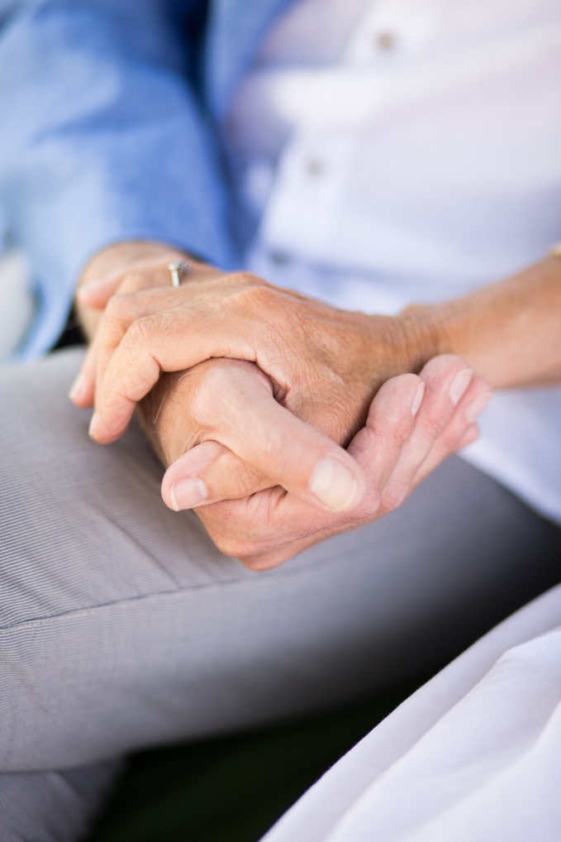
Challenging Conversations
Best Case / Worst Case:
Best case/worst case discussion for treatment of metastatic disease –surgery, chemotherapy, radiation and decision on palliative care and hospice
Risk / Benefit of Intervention:
Shared decision making for treatment of metastatic disease –surgery, chemotherapy, radiation

Slide 17
Interprofessional Focus
What role do other disciplines play in this patient’s end-of-life care?
Pharmacy
Nursing,
Social work
Who can help you provide the best care and honor the patient’s wishes?
Truth-telling to patient
Family may refuse telling patient that treatment is not effective any more

Slide 18
Interprofessional Focus
How will you approach utilizing a team approach to providing care?
Beyond referrals, how will you become comfortable with going outside your comfort zone?
Are there any integrative, traditional, or complementary therapies that will help the patient at this stage or later?

Slide 19
Questions to Consider
?
Can you identify any overarching bias?
Can you identify any possible assumptions one might make about this patient?
What information about this patient might inform public policy or regulatory action?

Slide 20
Teaching Points
Check boxes to indicate 3-5 teaching points:
x
ADVANCE CARE DIRECTIVE
Teaching point: Each health science student should be
knowledgeable about advance care directives; and
be able to communicate and engage patients / families in advance care planning across settings and across the lifespan.
x
PALLIATIVE CARE AND HOSPICE
Teaching point: Each health science student should be
knowledgeable about palliative care and hospice; and
be able to effectively communicate this information to patients / families.

Slide 21
Teaching Points
Teaching Points
Check boxes to indicate 3-5 teaching points:
x
CULTURAL HUMILITY
Teaching point: Each health science student should be
knowledgeable about cultural considerations in the care of patients and families, and
be able to effectively communicate with humility, curiosity, care, respect, and dignity.
x
COMMUNITY RESOURCES
Teaching point: Each health science student should be
knowledgeable about community resources to support serious illness and end-of-life care, and
be able to effectively connect patients/families with these resources.

Slide 22
Teaching Points
Check boxes to indicate 3-5 teaching points:
x
CHALLENGING CONVERSATIONS
Teaching point: Each health science student should be
knowledgeable about how to deliver “best case / worst case” and
be able to effectively conduct challenging conversations with patients / families (including how to discuss risk / benefits of interventions).
x
INTERPROFESSIONAL CARE
Teaching point: Each health science student should be
knowledgeable about the role of team members & benefits of team-based care and
be able to effectively work with team members in the care of patients / families with serious illness or at the end-of-life.

Slide 23
Resources
https://www.raisingarizonakids.com/pediatricyoung-adult-cancer-resources/
https://www.candlelightersaz.org/
https://www.amandahope.org/resources

Slide 24
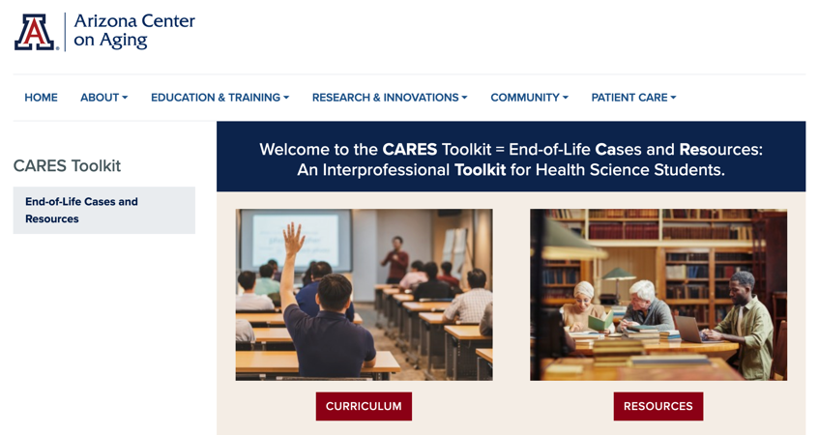
Thank
you
Please visit the Center on Aging
aging.arizona.edu
for more information on the CARES Toolkit
and other end-of-life resources
This project was funded by a grant from the David and Lura Lovell Foundation

