Slide 1
The CARES Toolkit
End-of-Life Cases and Resources:
An Interprofessional Toolkit for Health Science Students
Case Name: 82-Year-Old Woman Living with Dementia
College:
Course:
Instructor:

Slide 2
Learning Topics
1. Know about the role of palliative and hospice care in the management of persons living with dementia
2. Know about community resources to support persons, and their families, living with dementia
3. Know about the role of the interprofessional team in the care of patients living with dementia, and their families
4. Know about the importance of conducting advance care planning conversations throughout the life course.

Slide 3
Specific Communication / Conversation Skills
1. Be able to communicate and engage patients/families in advance care planning for patients with early to moderate dementia
2. Know how to conduct challenging conversations with patients and families, including discussing the diagnosis of dementia
3. Know how to identify goals of care, preference and values for persons living with dementia

Slide 4
Interprofessional Team Members
Team Members / Role:
Social Work/Public Health - advance care planning, connect to community resources
Nutrition -
Nursing, Physical and Occupational Therapy - strategies for safe home management
Pharmacy - safe and effective medication management for behavior, and polypharmacy

Slide 5
Case Summary
Setting of Encounter: 82-year-old woman comes into clinic with her daughter for an initial visit.
Context / Reason for Encounter #1: Patient’s only complaint is knee and hip pain (mild). The daughter is concerned about her mother’s function. The patient is independent in activities of daily living (ADLs), dependent in instrumental activities of daily living (IADLs), assists with cooking.
To establish care with a new doctor. Patient doesn’t express any concerns except mild knee and hip pain; family concerned about her decline and needing more “help.” Family looking for answers. Patient is not concerned about her memory.
*Opportunity to assess cognition and deliver diagnosis, likely Alzheimer's disease and related dementias (ADRD)—and to discuss goals of care, what matters most.

Slide 6
Demographics
Gender: Female
Age: 82-years-old
Ethnicity: White/non-hispanic
Living Situation: Lives in midtown Tucson with one of her daughters, her granddaughter and great grandson. Daughter is a licensed practical nurse who works 30 hours per week. Her granddaughter has a 2-year-old son. Extended family includes 3 sons and another daughter that have families; one daughter lives out of town. Unclear who is designated medical power of attorney (MPOA). Family is close. Many have input about mom’s care. Minimal financial resources within the family. They feel safe in their home.
Occupation: Unemployed now — was a mother and a house cleaner.
Insurance Coverage: Medicare

Slide 7
Demographics
Family / Caregiver Issues: Part of the family requesting a feeding tube, part of the family does not want it. Daughter and granddaughter care for her and their family comes to help at times. Husband passed away 10 years ago. All children and grandchildren live in Tucson.
Social Economic Status: SS check ($930) each month. Shares this with her daughter and the family takes care of her needs.
Social Determinants of Health: Finished 8th grade. Daughter cares for her as does her granddaughter. They have one car, able to purchase food and medicine.
Social / Mental Health Wellbeing: Prays as wellness practice
Religious / Spiritual Considerations: Catholic, was active in church, family does not take her often now.
Cultural Beliefs / Perspectives: Catholic beliefs and shared by her family. Catholic, was very involved in local community and church.

Slide 8
Patient Health Information
History of Present Illness
82-year-old woman with multiple issues, including well-controlled diabetes, high blood pressure, osteoarthritis of both knees and hips, and some difficulty hearing. She complains of difficulty walking because of her arthritis, but otherwise doesn’t have any other concerns.
The daughter says that her mother moved in with her a few years ago because she thought her mother needed “help” with her medications- and she has noticed that her mother has needed more help over the year. Daughter manages the medications, and all finances. The patient is independent in ADLs, dependent in IADLs, assists with cooking. She is concerned. On MoCA mental status exam = 18

Slide 9
Patient Health Information
Illness Course / Treatment Information:
Physical Exam:
Looks stated age. Attentive, can answer yes/no to simple questions, and speak in short sentences. No spontaneous conversation. MMSE = 9
Patient is 5’1”, weight = 101 lb BMI-19.
Poor dentition. Hard of hearing.
Mucous membranes
CN 2-12 Normal
Thyroid: WNL
CVS: normal capillary refill hands and feet. BP=120/75, HR: 80 and regular, normal S1, S2, no extra sounds or mms.
Resp: RR=12, no wheezes or crackles throughout.
GI- Unremarkable
PPP, Able to use all limbs, no swelling, no bruising. Gait unstable yet can walk. Skin intact.

Slide 10
Patient Health Information
Medications / Treatments: Chlorthalidone 25mg per day, Lisinopril 10mg per day; Metformin XR 1000mg BID; acetaminophen 650 mg TID. Takes medicine with apple sauce to swallow.
Allergies / Intolerances: No known allergies.
Tobacco, Alcohol or Substance Use: No tobacco, alcohol or other substance use.
Review of Systems: No history of colonoscopy or mammograms - patient has denied in the past. Last blood work 3 years ago.
Past Medical History: Hypertension (HTN) diagnosed 3 years ago. Type 2 diabetes, well controlled. Hard of hearing - moderate. Osteoarthritis of both hips and knees (mild) with gait instability.
Family History: Moved here with husband 58 years ago. Husband passed away 5 years ago. All children and grandchildren live in Tucson.

Slide 11
Health and Community Services
Identify any existing or needed health or community-based services:
Healthcare Services: Eligibility / Enrollment / Contact Information
Patient has Medicare
Community Services: Eligibility / Enrollment / Contact Information
Patient is not receiving any community-based services

Slide 12
Overall Assessment
Encounter #1 Clinic: The patient is an older adult with moderate dementia (major neurocognitive disorder), likely Alzheimer’s Disease and Related Dementia, MMSE = 15.
Optimal care would include:
making the diagnosis (e.g., labs, imaging, medication review, etc.);
sharing the diagnosis with the patient and family (e.g., family meeting?);
providing support to the patient and caregivers, optimizing safety and quality of life, and
discussing advance care planning, what matters most. Unfortunately, due to multiple reasons, the patient did not complete the evaluation, and did not return to clinic for 3 years.
Encounter #2 Primary Care: The patient has advancing dementia, and the patient and family return with many concerns, including dysphagia and weight loss; impairment in ADLs including requiring help with bathing, eating and toileting (uses incontinence pads); insomnia and intermittent nighttime agitation; general apathy with decreased words; and high risk for falls. The family is asking about feeding tube options, help with mobility, and concerns about future care needs. They wonder if the patient should be on more medications? Or less medications? They do not seem to know much about dementia, and don’t know about resources.

Slide 13
Advance Care Planning
None. No Power of Attorney (POA) has been designated. Part of the family requesting a feeding tube, part of the family does not want it. No do-not-resuscitate (DNR) order.
Encounter #1 - MMSE = 15: Is she able to make decisions, such as assigning a durable medical power of attorney? (Yes).
Encounter #2 - MMSE = 9. Dementia has advanced. Is she able to make decisions? Family split on feeding tube or no feeding tube. They want her to live as long as possible, feel they cannot afford care except the living situation she is in now.

Slide 14
Advance Care Planning
Advance Care Planning
What matters most to the patient now?
Encounter #1: The patient is concerned about her knee and hip pain, and difficulty walking. She is not concerned about her memory loss.
Encounter #2: The patient does not express any concerns, but the family reports that she becomes agitated at time, and depressed, with erratic sleep schedule, and instability.
What do they want their health for?
Encounter #1: The patient wants to be able to walk safely. Otherwise, no other concerns were elicited.
Encounter #2: Not elicited

Slide 15
Next Steps / Outcomes
What happens next:
What is most important at this stage?
How do you determine what matters most to the patient/family and goals of care?
What are possible evaluation and management strategies for some of the patient/family concerns (e.g., weight loss and dysphagia, mood disturbance w insomnia, incontinence, type of dementia, gait assessment, medication review, and community support and caregiver support for family?
What is the benefit, if any, of feeding tube?
What can home health and/or hospice care offer?
Details about family conversations:
What happens at, or near, death of patient:
What support does family need before and after death of patient:

Slide 16
Challenging Conversations
Best Case / Worst Case:
PEG tube feedings
Risk / Benefit of Intervention:
Medication management of neurocognitive and behavioral issues

Slide 17
Interprofessional Focus
What role do other disciplines play in this patient’s end-of-life care?
Social Work/Public Health - advance care planning, connect to community resources
Nutrition -
Nursing, Physical and Occupational Therapy - strategies for safe home management
Pharmacy - safe and effective medication management for behavior, and polypharmacy
Who can help you provide the best care and honor the patient’s wishes?
All members of the team

Slide 18
Interprofessional Focus
How will you approach utilizing a team approach to providing care?
Determine the most efficient ways for the team to communicate and share ideas as a team.
Beyond referrals, how will you become comfortable with going outside your comfort zone?
Are there any integrative, traditional, or complementary therapies that will help the patient at this stage or later?

Slide 19
Questions to Consider
?
Can you identify any overarching bias?
Ageism.
Important to recognize and support the patient’s personhood.
Can you identify any possible assumptions one might make about this patient?
What information about this patient might inform public policy or regulatory action?
Action or policy to support caregivers in the community, and dementia-friendly cities.

Slide 20
Teaching Points
Check boxes to indicate 3-5 teaching points:
x
ADVANCE CARE DIRECTIVE
Teaching point: Each health science student should be
knowledgeable about advance care directives; and
be able to communicate and engage patients / families in advance care planning across settings and across the lifespan.
x
PALLIATIVE CARE AND HOSPICE
Teaching point: Each health science student should be
knowledgeable about palliative care and hospice; and
be able to effectively communicate this information to patients / families.

Slide 21
Teaching Points
Teaching Points
Check boxes to indicate 3-5 teaching points:
x
CULTURAL HUMILITY
Teaching point: Each health science student should be
knowledgeable about cultural considerations in the care of patients and families, and
be able to effectively communicate with humility, curiosity, care, respect, and dignity.
x
COMMUNITY RESOURCES
Teaching point: Each health science student should be
knowledgeable about community resources to support serious illness and end-of-life care, and
be able to effectively connect patients/families with these resources.

Slide 22
Teaching Points
Check boxes to indicate 3-5 teaching points:
x
CHALLENGING CONVERSATIONS
Teaching point: Each health science student should be
knowledgeable about how to deliver “best case / worst case” and
be able to effectively conduct challenging conversations with patients / families (including how to discuss risk / benefits of interventions).
x
INTERPROFESSIONAL CARE
Teaching point: Each health science student should be
knowledgeable about the role of team members & benefits of team-based care and
be able to effectively work with team members in the care of patients / families with serious illness or at the end of life.

Slide 23
Resources
Area Agency on Aging (Pima Council on Aging)
Alzheimer’s Association

Slide 24
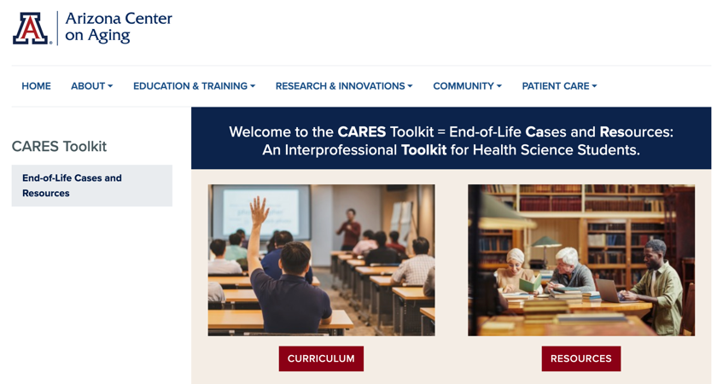
Thank
you
Please visit the Center on Aging
aging.arizona.edu
for more information on the CARES Toolkit
and other end-of-life resources
This project was funded by a grant from the David and Lura Lovell Foundation

