Slide 1
The CARES Toolkit
End-of-Life Cases and Resources:
An Interprofessional Toolkit for Health Science Students
Case Name: 30-Year-Old White Man Living with ALS — Scenario 2
College:
Course:
Instructor:

Slide 2
Learning Topics
1.
2.
3.

Slide 3
Specific Communication / Conversation Skills
1.
2.
3.

Slide 4
Interprofessional Team Members
Team Members/Role:

Slide 5
Case Summary
Setting of Encounter: Home
Context: As the Nurse Practitioner (NP) on call, you receive a request to do a home visit. Dr. Stephen Jones, NP, diagnosed with amyotrophic lateral sclerosis (ALS) is in extreme pain. You know Stephen because he was a student that was in your Doctor of Nursing (DNP) classes when you were a faculty member at the College of Nursing. You assess the situation and ascertain that a home visit is necessary. The girlfriend of the patient, Carol, is extremely distressed and therefore unable to describe the situation effectively. When you arrive at the house, Stephen is lying in bed, very disheveled and unable to sleep due restlessness and pain. He recognizes you, although his pain is intense, he seems embarrassed that you see him like this. You assess him and find that his respirations are shallow, and he is cachectic. You talk with Stephen and Carol after your assessment of Stephen.
Reason for Encounter: Severe Pain

Slide 6
Demographics
Patient Name: Stephen Jones
Gender: Male (he, him)
Age: 30-years-old
Ethnicity: White
Living Situation: Private Residence
Occupation: Family Physician, self-employed but unable to work now
Insurance Coverage: Uninsured, self-pay

Slide 7
Demographics
Family / Caregiver Issues: He has no children or siblings. Stephen lives with his partner Carol. She took family medical leave from her job as an ER nurse to take care of Stephen. Stephen moonlighted during residency on free weekends providing substitute coverage (locum tenens) that paid $200 per hour but provided no health benefits. He continued this work after finishing his residency. At the time of his ALS diagnosis six months ago he was self-employed.
Social Economic Status:
Social Determinants of Health:
Social / Mental Health Wellbeing:
Religious / Spiritual Considerations:
Cultural Beliefs / Perspectives:

Slide 8
Patient Health Information
History of Present Illness: Stephen Jones is a 30-year-old male with severe (8 out of 10) pain increasing over the last 24 hours. He was diagnosed with ALS six months ago, shortly after finishing his residency program. His course has been rapidly progressive, and he is now very emaciated and weak, limited to his bed. Steven says he is very anxious – partially because of the severe pain, but he also worries about his debts - his $250,000 in student loans and $300,000 house mortgage. He has no way to pay off his debt now. Carol says that over the past few weeks Stephen is not interested in food and is able to take only small sips of juice and water due to difficulty in swallowing. He is no longer able to carry on daily living activities – he cannot feed himself, ambulate or use his arms or legs.
Illness Course / Treatment Information:

Slide 9
Patient Health Information
Physical Exam:
Vital Signs: Ht: 6ft 2in; Wt: 135 lbs; Pulse: 92; BP: 90/64; Respiratory Rate 18
General: Emaciated male, lying immobile in a hospital bed in his living room. He immediately recognizes you and smiles. He answers questions in a barely audible whisper, and nods or shakes his head for yes/no answers. He winces in pain as you gently examine him.
Neurologic: Alert, oriented to person, place and time. His reflexes are brisk, with several beats of clonus in his upper extremities. He has a Babinski sign on the right foot, and a Hoffman’s sign in his right thumb and index finger.
Musculoskeletal: Upper and lower extremity muscles are atrophied throughout. He has muscle fasciculations in his thighs and calves.
Skin: There are no decubitus ulcers nor evidence of skin breakdown.
Lungs: Shallow respirations
Heart: Tachycardia at 92, no murmurs
Abdomen: Bowel sounds are present. No masses.
Genital: Foley catheter in place, dark colored urine is trickling slowly into the bag.
Rectal: Declined. The stool in hemoccult negative.

Slide 10
Patient Health Information
Medications / Treatments: Morphine sulfate liquid 10mg/ml every 8 hours as needed for pain.
Allergies / Intolerances: No Allergies
Tobacco, Alcohol or Substance Use: Tobacco: none; alcohol: none.
Review of Systems:
Past Medical History: No significant past medical history
Family History: He has no children or siblings. No history of ALS in the family. His 58-year-old mother is healthy. His dad died of an acute myocardial infarction at age 62.

Slide 11
Health and Community Services
Identify any existing or needed health or community-based services:
Healthcare Services: Eligibility / Enrollment / Contact Information
Community Services: Eligibility / Enrollment / Contact Information

Slide 12
Overall Assessment
Acute, severe pain in a patient with advanced ALS

Slide 13
Advance Care Planning
Comfort measures
Do not hospitalize, intubate, or place a feeding tube.
He wishes to “die at home if possible.”

Slide 14
Advance Care Planning
Advance Care Planning
What matters most to the patient now?
He wants to remain at home and die at home, however, his girlfriend Carol wants him transferred for pain care to the hospital.
What do they want their health for?

Slide 15
Next Steps / Outcomes
What happens next:
Details about family conversations:
What happens at, or near, death of patient:
What support does family need before and after death of patient:

Slide 16
Next Steps / Outcomes
Questions to Consider: see General Questions in Facilitator’s notes. This scenario includes prompting questions about self-care for the healthcare provider.
What health services might Stephen be eligible for that he can receive at home?
What can be done to better control his pain and anxiety?
What health insurance coverage might Steven Jones be eligible for in his current condition?
What more do you need to know about his current directives, or if he wishes to modify them?
What can be done about his financial situation – affordable care, medications, respite care, accrued student loan debt, mortgage? Who will assume his obligations?
What policy issues need attention in terms of health professions education costs?

Slide 17
Challenging Conversations
Best Case / Worst Case:
Risk / Benefit of Intervention:

Slide 18
Interprofessional Focus
What role do other disciplines play in this patient’s end-of-life care?
Who can help you provide the best care and honor the patient’s wishes?

Slide 19
Interprofessional Focus
How will you approach utilizing a team approach to providing care?
Beyond referrals, how will you become comfortable with going outside your comfort zone?
Are there any integrative, traditional, or complementary therapies that will help the patient at this stage or later?

Slide 20
Questions to Consider
?
Can you identify any overarching bias?
Can you identify any possible assumptions one might make about this patient?
What information about this patient might inform public policy or regulatory action?

Slide 21
Teaching Points
Check boxes to indicate 3-5 teaching points:
x
ADVANCE CARE DIRECTIVE
Teaching point: Each health science student should be
knowledgeable about advance care directives; and
be able to communicate and engage patients / families in advance care planning across settings and across the lifespan.
x
PALLIATIVE CARE AND HOSPICE
Teaching point: Each health science student should be
knowledgeable about palliative care and hospice; and
be able to effectively communicate this information to patients / families.

Slide 22
Teaching Points
Teaching Points
Check boxes to indicate 3-5 teaching points:
x
CULTURAL HUMILITY
Teaching point: Each health science student should be
knowledgeable about cultural considerations in the care of patients and families, and
be able to effectively communicate with humility, curiosity, care, respect, and dignity.
x
COMMUNITY RESOURCES
Teaching point: Each health science student should be
knowledgeable about community resources to support serious illness and end-of-life care, and
be able to effectively connect patients/families with these resources.

Slide 23
Teaching Points
Check boxes to indicate 3-5 teaching points:
x
CHALLENGING CONVERSATIONS
Teaching point: Each health science student should be
knowledgeable about how to deliver “best case / worst case” and
be able to effectively conduct challenging conversations with patients / families (including how to discuss risk / benefits of interventions).
x
INTERPROFESSIONAL CARE
Teaching point: Each health science student should be
knowledgeable about the role of team members & benefits of team-based care and
be able to effectively work with team members in the care of patients / families with serious illness or at the end of life.

Slide 24
Resources
I am ALS https://iamals.org/
Advanced Care Planning for ALS https://iamals.org/get-help/advanced-care-planning-for-als/
ALS Association (includes information on Understanding ALS, Navigating ALS, and End-of-Life Plans) https://www.als.org/

Slide 25
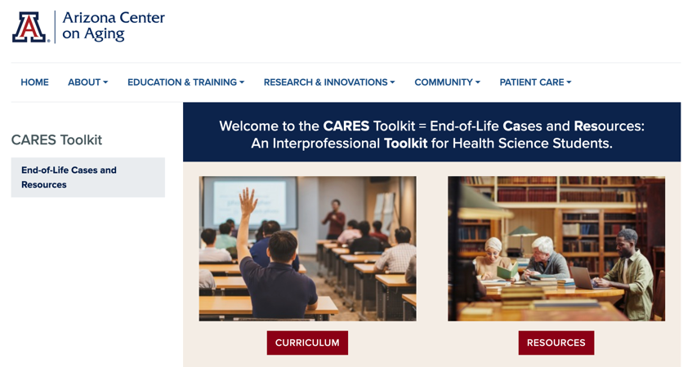
Thank
you
Please visit the Center on Aging
aging.arizona.edu
for more information on the CARES Toolkit
and other end-of-life resources
This project was funded by a grant from the David and Lura Lovell Foundation

