Slide 1
The CARES Toolkit
End-of-Life Cases and Resources:
An Interprofessional Toolkit for Health Science Students
Case Name: 46-Year-Old Woman Living with Metastatic Breast Cancer — Scenario 2
College:
Course:
Instructor:

Slide 2
Learning Topics
1.
2.
3.

Slide 3
Specific Communication / Conversation Skills
1.
2.
3.

Slide 4
Interprofessional Team Members
Team Members/Role:

Slide 5
Case Summary
Setting of Encounter: Home
Home Visit: After patient has been informed that the chemotherapy will be stopped, and primary care physician is recommending palliative care.
Context: Home visit – the patient has been informed that the chemotherapy will be stopped, and the cancer has metastasized to her lungs, which is evident in a PET scan. The home health nurse is visiting to see if she can facilitate a palliative care or even a hospice consult.
Reason for Encounter: Palliative care referral from healthcare provider. Stage 4, triple negative breast cancer (TNBC).
Capecitabine has been discontinued and she is at home, feeling better than she has in a long time, since she started it. The home health nurse is stopping by to talk to her about some treatments called palliative that will make her feel even better.

Slide 6
Demographics
Gender: Female
Age: 46-years-old
Ethnicity: Prefers not to identify
Living Situation: Four (patient and 3 children) living in small apartment with 2 bedrooms. The children are ages 4, 10 and 12. English is primary language. Same-sex partner has abandoned family and has not responded to any attempts for contact.
Occupation: Licensed Practical Nurse (no longer working)
Insurance Coverage: United Healthcare provided by employer. No short-term disability option

Slide 7
Demographics
Family / Caregiver Issues: Patient is caregiver to 3 children. Divorced and estranged from same-sex partner of 15 years. Has 3 children, ages 4 (f), 10 (m) and 12 (f).
Social Economic Status: Lower-middle class
Social Determinants of Health: She is living paycheck to paycheck, drives car, steady employment for last 10 years, health literate, educated as LPN and works at long term care facility.
Social / Mental Health Wellbeing: Tries to meditate when has the time
Religious / Spiritual Considerations: She had Catholic religious beliefs but now feels abandoned by God because of her illness and partner leaving.
Cultural Beliefs / Perspectives:

Slide 8
Patient Health Information
History of Present Illness: Otherwise, healthy, post-menopausal female palpated a mass in her left breast upon self-exam. Initial examination with fine need aspiration showed a malignant tumor approximately 2 cm tumor with axillary lymph node involvement. Following a left breast mastectomy, the mass was confirmed as triple negative breast cancer (ypT2N1), 4 nodes were positive. Following 12 months of capecitabine oral chemotherapy treatment, patient responded well. Patient is aware of lung lesions and has stopped oral chemo treatments. She is feeling better, nausea is less, and diarrhea has stopped. She gets weary in the afternoon and needs to take a rest, sometime after getting short of breath. The oncologist has ordered a palliative care consult at her home.
Illness Course / Treatment Information: Diagnosis of Stage 4 triple negative breast cancer 2 years ago. 12-month course of oral capecitabine and mastectomy. Recently PET scan shows 2 small lesions biopsied as TNBC. Recommend comfort care.
Physical Exam: Alert, oriented, pleasant female. Appears frail for age. Height 5’9”, weight 115 lbs. Experienced recent weight loss. Skin warm and dry. Mucosa of mouth and eyes dry. Head is normocephalic with patches of hair loss. ENT normal. Cardiac assessed with normal rate and rhythm, no murmurs with normal S1 S2 intensity. Lungs dim in left upper and lower lobes. Right lung clear. Consistent, unproductive cough, no rhonchi upon auscultation. Left chest wall thin, post mastectomy 15 months prior, incision scar well healed. Right breast no masses palpated. Abdomen is soft with hyperactive bowel sounds. Mood and affect appropriate for situation. Expresses concern for her children’s care due to her extreme fatigue.

Slide 9
Patient Health Information
Medications / Treatments: Capecitabine discontinued. Ativan 10 mg before bed; Zofran 8 mg prn for nausea/vomiting, Imodium as needed for diarrhea; Xanax .5 mg 3 times/day; Zestril 10 mg QD, Vicks Dayquil Cough as needed for cough.
Allergies / Intolerances: No known allergies (NKA)
Tobacco, Alcohol or Substance Use: No
Review of Systems: Patient is mobile, however weak due to nausea with vomiting, and diarrhea. She can comfortably move around 2nd floor apartment but risks falling on steps up to apartment due to weakness. Lack of sleep with daytime fatigue. Poor appetite.
Past Medical History: Physically healthy until diagnosed with TNBC. Treated for depression when her partner abandoned her and the children.
Family History: Both parents have died. Father (78-years-old) from melanoma and mother (29-years-old) automobile accident. No other support systems.

Slide 10
Health and Community Services
Identify any existing or needed health or community-based services:
Healthcare Services: Eligibility / Enrollment / Contact Information
The 12-year-old daughter has recently been exposed to TB recently at a friend’s house and is not allowed to return to school until she can get him a chest x-ray.
Community Services: Eligibility / Enrollment / Contact Information
She currently receives support for child daycare for 4-year-old. Other two children attend school. Will need help with childcare.

Slide 11
Overall Assessment
Metastasis of left breast cancer, TNBC, to left lung. IV chemotherapy treatments available however will further reduce quality of life and only increase life expectancy by 6 months at most. Prognosis poor. Recommend palliative care to start making decisions for herself and children.

Slide 12
Advance Care Planning
Patient doesn’t know where to start because there is no one that she can think of that would take all 3 of her children and she doesn’t want them split up. She is going to try alternative treatments such as nutrition therapy, and ozone therapy that will slow down the cancer.
If she can just stay alive for at least 4-5 years, to see them graduate from high school, then they will be on their own. Her daughter will be old enough to take care of the other children.

Slide 13
Advance Care Planning
Advance Care Planning
What matters most to the patient now?
Spending quality time with her children and not have them think of her as “sick.” She wants to be able to get up in the morning and make them breakfast and walk them to the school bus stop and daycare center.
What do they want their health for?
To be able to see all three children graduate from high school.

Slide 14
Next Steps / Outcomes
What happens next:
Who can help her with shared decision making for determining level of aggressiveness of treatments?
What is most important at each setting?
How do you determine what matters most to the patient/family and goals of care?
Quality or quantity decisions need to be made.
Details about family conversations:
What happens at, or near, death of patient:
What support does family need before and after death of patient:

Slide 15
Challenging Conversations
Best Case / Worst Case:
Risk / Benefit of Intervention:

Slide 16
Interprofessional Focus
What role do other disciplines play in this patient’s end-of-life care?
Who can help you provide the best care and honor the patient’s wishes?

Slide 17
Interprofessional Focus
How will you approach utilizing a team approach to providing care?
Beyond referrals, how will you become comfortable with going outside your comfort zone?
Are there any integrative, traditional, or complementary therapies that will help the patient at this stage or later?

Slide 18
Questions to Consider
?
Can you identify any overarching bias?
Can you identify any possible assumptions one might make about this patient?
What information about this patient might inform public policy or regulatory action?

Slide 19
Teaching Points
Check boxes to indicate 3-5 teaching points:
x
ADVANCE CARE DIRECTIVE
Teaching point: Each health science student should be
knowledgeable about advance care directives; and
be able to communicate and engage patients / families in advance care planning across settings and across the lifespan.
x
PALLIATIVE CARE AND HOSPICE
Teaching point: Each health science student should be
knowledgeable about palliative care and hospice; and
be able to effectively communicate this information to patients / families.

Slide 20
Teaching Points
Teaching Points
Check boxes to indicate 3-5 teaching points:
x
CULTURAL HUMILITY
Teaching point: Each health science student should be
knowledgeable about cultural considerations in the care of patients and families, and
be able to effectively communicate with humility, curiosity, care, respect, and dignity.
x
COMMUNITY RESOURCES
Teaching point: Each health science student should be
knowledgeable about community resources to support serious illness and end-of-life care, and
be able to effectively connect patients/families with these resources.

Slide 21
Teaching Points
Check boxes to indicate 3-5 teaching points:
x
CHALLENGING CONVERSATIONS
Teaching point: Each health science student should be
knowledgeable about how to deliver “best case / worst case” and
be able to effectively conduct challenging conversations with patients / families (including how to discuss risk / benefits of interventions).
x
INTERPROFESSIONAL CARE
Teaching point: Each health science student should be
knowledgeable about the role of team members & benefits of team-based care and
be able to effectively work with team members in the care of patients / families with serious illness or at the end of life.

Slide 22
Resources

Slide 23
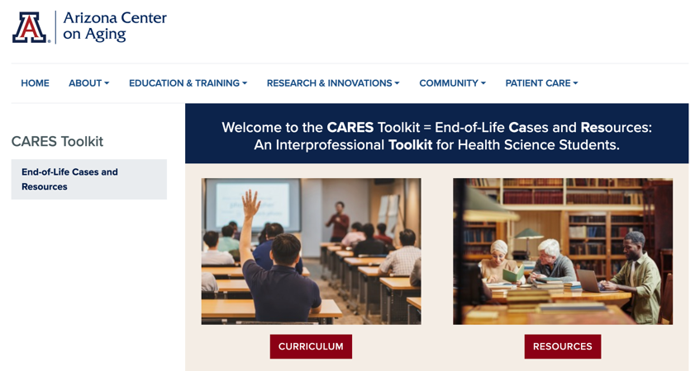
Thank
you
Please visit the Center on Aging
aging.arizona.edu
for more information on the CARES Toolkit
and other end-of-life resources
This project was funded by a grant from the David and Lura Lovell Foundation

