Slide 1
The CARES Toolkit
End-of-Life Cases and Resources:
An Interprofessional Toolkit for Health Science Students
Case Name: 14-Year-Old Latino Boy Living with Bone Cancer — Scenario 1
College:
Course:
Instructor:

Slide 2
Learning Topics
Ethics of difficult conversations and use of medically trained interpreters
Interprofessional approach to care for children and adolescents with severe chronic illness or at the end of life
Treatment decision making for children and adolescents
Cultural aspects of care of Latinx families, decision making, ethics and language challenges.
Holding family meetings, cultural aspects of communication, importance of interprofessional communication, involvement of faith-community, as appropriate, when delivering bad news or conversations at the end of life
Access to health care for undocumented and children of undocumented parents. State healthcare programs for children and adolescents. Healthcare coverage in the state of Arizona considering immigration status, limitations of emergency AHCCCS.
Appropriate spiritual assessment and faith assessment and if possible, their faith-based community as members of the healthcare team
Treatment preferences, complementary and alternative treatments for cancer, cultural aspects, and interaction with chemotherapy
Difference in palliative care/hospice care for children and adolescents

Slide 3
Specific Communication / Conversation Skills
1.
2.
3.

Slide 4
Interprofessional Team Members
Team Members/Role:
Nurse practitioner (NP) will provide a holistic approach to patient and family, the NP role will vary based on their clinical setting in relation to the patient.
Nurse practitioner role as provider to patient:
NP is to provide appropriate medical treatment options
NP is the patient care navigator, care coordinator and can lead the planning for meetings and who should attend and when
NP can provide culturally appropriate materials for the patient and family
NP can help the parents with the conversation with the adolescent and other family members
Nurse practitioner role as provider to parent/family members:
NP will provide support to parent(s), family members
NP might also need to treat parent(s), family for any stress induced symptoms after diagnosis i.e. support and referrals as needed for treatment options for family including for depression and stress related to the diagnosis.
Potential NP roles in the care of this patient: PNP, acute care NP, PMHNP-for the patient, FNP and PMHNP for the parents, family, friends, significant other, etc.

Slide 5
Interprofessional Team Members
Nurse Practitioner Roles with Patient: Have appropriate culture resources including medically trained interpreter as needed. The adolescent has to be actively involved in the conversations and opinion must be elicited and respected. Developmentally, the adolescent’s peer group is the strongest personal relationship and should be encouraged to visit and engage with the patient. The NP can provide information to the peers to encourage age-appropriate interactions with the adolescent patient.
Nurse Practitioner Roles with Parents: Support with medically trained interpreters. Include any important members of the parent/families’ support system- i.e. priest or anyone the family deems as a significant member/support for the family.
Additionally: NP role is to provide and reinforce education on the importance of follow-up regardless of diagnostics.
NP assumes the role of care coordinator/patient and family navigator and is the consistent person in the patient’s care and is typically the one that the family sees the most. The NP typically is the one person that the patient and family asks about treatment options, etc.

Slide 6
Case Summary
Setting of Encounter: Community site – Clinica Amistad
Context: Parents are patients of Clinica Amistad and bring their son to clinic because of leg pain
Reason for Encounter: Parents are uninsured and had not done the paperwork for child to have ACCCHS coverage. Child has been healthy and only needing immunizations or sports physicals, pain that is debilitating and not getting better in left leg.

Slide 7
Demographics
Gender: Male
Age: 14-years-old
Ethnicity: Latino- Mexican-American or Central American
Living Situation: Lives with parents, and siblings- grandparents in Mexico. Spanish is spoken at home, he speaks English, but parents speak only Spanish. Need for certified interpreter rather than allowing patient to fall into what is probably a familiar role of interpreting for parents.
Occupation: Freshman in High School.
Insurance Coverage: Parents are undocumented and don’t have insurance. Patient is eligible for diagnostic tests available through AHCCCS emergency, however AHCCCS will not cover chemotherapy. Patient may qualify for Indian Health Services if there is a tribal connection. Another option is the transfer of the patient to one of the large children’s hospitals in Mexico.
Family / Caregiver Issues:

Slide 8
Demographics
Social Economic Status: Both parents work- father in construction and mother cleaning houses. Patient goes to public school. The financial piece can be huge- not just the medical bills but time off work.
Social Determinants of Health: Assessment of food or housing or transportation insecurity; utility need; financial resources; childcare; education; employment instability; legal resources; social isolation; health literacy.
Marital Status / Significant Other / Children or Other Dependents:
Social / Mental Health Wellbeing:
Religious / Spiritual Considerations: Catholic but not very religious, close-knit family and involvement with extended family. Offer faith-based counsel, ask don’t assume “Are there any religious or cultural practices you would like to have for patient?”
Cultural Beliefs / Perspectives:

Slide 9
Patient Health Information
History of Present Illness: Parents are patients of Clinica Amistad and bring their son because of leg pain- first encounter, discussing initial diagnosis. Leg pain, unable to play soccer and hard to ambulate.
Illness Course / Treatment Information: Diagnosis, discussion of treatment and prognosis and finally discussing failure of treatment and palliative medicine/hospice. Sometimes when parents are undocumented there is fear/anger that options being presented are being limited because of parents’ status.
Physical Exam: Underweight, but otherwise normal exam.
Medications / Treatments: No medications other than acetaminophen and ibuprofen for pain.
Allergies / Intolerances: None.
Tobacco, Alcohol or Substance Use:

Slide 10
Patient Health Information
Wellness Practices: Does well at school, interested in math and science, loves soccer. Maintaining contact with friends? School is kid’s work- sometimes going back is really important even if everyone understands that the goal is socialization not matriculation.
Review of Systems: Freely mobility, with excellent cognition, aggravated mood due to pain; do they need assistive devices? Limited area for exercise in current living environment.
Past Medical History: No medical history
Family history: Diabetes and heart disease runs in family.

Slide 11
Health and Community Services
Identify any existing or needed health or community-based services:
Healthcare Services: Eligibility / Enrollment / Contact Information
Community Services: Eligibility / Enrollment / Contact Information

Slide 12
Overall Assessment

Slide 13
Advance Care Planning
Advanced Care Planning has never been considered.
Palliative care should be offered throughout the entire treatment course- it is NOT an option of last resort, it is woven throughout, every time you treat a symptom (pain, nausea from chemo/radiation, constipation from opioids) and every time you talk about what pts goals of care are. Hospice would be at end of case, and in kids, there is concurrent care provision, so could even be on hospice at the same time as receiving cure directed therapy (this is unique to peds).
Palliative care/hospice in pediatrics is the same philosophy but there tends to be more hesitancy in the pediatric population for all areas-providers, parents, patient, etc.
NP role is to help identify when the patient is ready to transition to palliative/hospice and provide the appropriate referrals.
NP role is to educate the adolescent and family about palliative care and how it can help the patient and family at this stage in the diagnosis. Palliative care/hospice does not mean you are dying tomorrow and that your physical and mental needs will not be met.

Slide 14
Advance Care Planning
Advance Care Planning
What matters most to the patient now?
Concern over potential for serious illness and importance of follow-up with diagnostic work up. Important to address patient and family. Family is fearful this could be a serious illness and they don’t have health insurance. Language barriers to understand health care access options.
What do they want their health for?
Patient wants to go back to his pre-diagnosis life, go to school, play soccer. Parents hope for a cure and keep optimism about prognosis. Young people often bow to the wishes of their parents in these cases.

Slide 15
Next Steps / Outcomes
What happens next: Follow up after diagnostic tests.
Details about family conversations: Parents concerned about finances and insurance coverage also fearful about their immigration status
What happens at, or near, death of patient:
What support does family need before and after death of patient:

Slide 16
Challenging Conversations
Best Case / Worst Case:
Risk / Benefit of Intervention:

Slide 17
Interprofessional Focus
What role do other disciplines play in this patient’s end-of-life care?
Pharmacy, Nursing, Social work, etc.
Who can help you provide the best care and honor the patient’s wishes?

Slide 18
Interprofessional Focus
How will you approach utilizing a team approach to providing care?
Beyond referrals, how will you become comfortable with going outside your comfort zone?
Are there any integrative, traditional, or complementary therapies that will help the patient at this stage or later?

Slide 19
Questions to Consider
?
Can you identify any overarching bias?
Can you identify any possible assumptions one might make about this patient?
What information about this patient might inform public policy or regulatory action?

Slide 20
Teaching Points
Check boxes to indicate 3-5 teaching points:
x
ADVANCE CARE DIRECTIVE
Teaching point: Each health science student should be
knowledgeable about advance care directives; and
be able to communicate and engage patients / families in advance care planning across settings and across the lifespan.
x
PALLIATIVE CARE AND HOSPICE
Teaching point: Each health science student should be
knowledgeable about palliative care and hospice; and
be able to effectively communicate this information to patients / families.

Slide 21
Teaching Points
Teaching Points
Check boxes to indicate 3-5 teaching points:
x
CULTURAL HUMILITY
Teaching point: Each health science student should be
knowledgeable about cultural considerations in the care of patients and families, and
be able to effectively communicate with humility, curiosity, care, respect, and dignity.
x
COMMUNITY RESOURCES
Teaching point: Each health science student should be
knowledgeable about community resources to support serious illness and end-of-life care, and
be able to effectively connect patients/families with these resources.

Slide 22
Teaching Points
Check boxes to indicate 3-5 teaching points:
x
CHALLENGING CONVERSATIONS
Teaching point: Each health science student should be
knowledgeable about how to deliver “best case / worst case” and
be able to effectively conduct challenging conversations with patients / families (including how to discuss risk / benefits of interventions).
x
INTERPROFESSIONAL CARE
Teaching point: Each health science student should be
knowledgeable about the role of team members & benefits of team-based care and
be able to effectively work with team members in the care of patients / families with serious illness or at the end of life.

Slide 23
Resources
https://www.raisingarizonakids.com/pediatricyoung-adult-cancer-resources/
https://www.candlelightersaz.org/
https://www.amandahope.org/resources

Slide 24
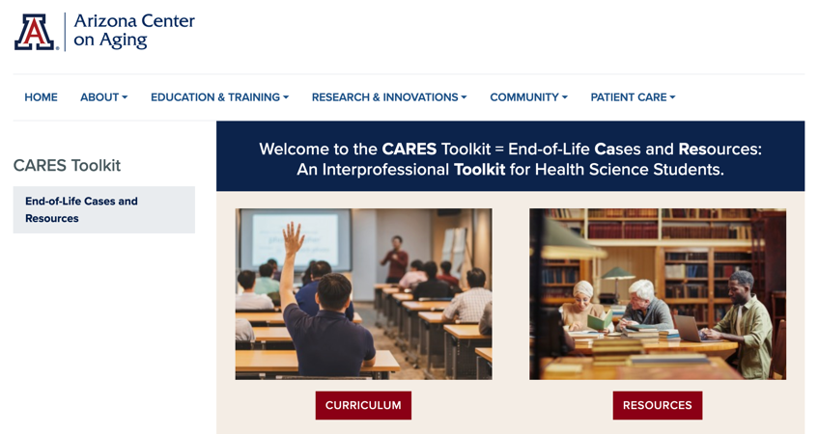
Thank
you
Please visit the Center on Aging
aging.arizona.edu
for more information on the CARES Toolkit
and other end-of-life resources
This project was funded by a grant from the David and Lura Lovell Foundation

