Slide 1
The CARES Toolkit
End-of-Life Cases and Resources:
An Interprofessional Toolkit for Health Science Students
Case Name: 14-Year-Old Latino Boy Living with Bone Cancer — Scenario 2
College:
Course:
Instructor:

Slide 2
Learning Topics
Ethics of difficult conversations and use of medically trained interpreters
Interprofessional approach to care for children and adolescents with severe chronic illness or at the end of life
Treatment decision making for children and adolescents
Cultural aspects of care of Latinx families, decision making, ethics and language challenges.
Holding family meetings, cultural aspects of communication, importance of interprofessional communication, involvement of faith-community, as appropriate, when delivering bad news or conversations at the end of life
Healthcare coverage in the state of Arizona and end-of-life services available through AHCCCS and Indian Health Services
Appropriate spiritual assessment and faith assessment and if possible, their faith-based community as members of the healthcare team
Treatment preferences, complementary and alternative treatments for cancer, cultural aspects, and interaction with chemotherapy
Difference in palliative care/hospice care for children and adolescents

Slide 3
Specific Communication / Conversation Skills
1.
2.
3.

Slide 4
Interprofessional Team Members
Team Members/Role:
Nurse practitioner (NP) will provide a holistic approach to patient and family, the NP role will vary based on their clinical setting in relation to the patient.
Nurse practitioner role as provider to patient:
NP is to provide appropriate medical treatment options
NP is the patient care navigator, care coordinator and can lead the planning for meetings and who should attend and when
NP can provide culturally appropriate materials for the patient and family
NP can help the parents with the conversation with the adolescent and other family members
Nurse practitioner role as provider to parent/family members:
NP will provide support to parent(s), family members
NP might also need to treat parent(s), family for any stress induced symptoms after diagnosis i.e. support and referrals as needed for treatment options for family including for depression and stress related to the diagnosis.
Potential NP roles in the care of this patient: PNP, acute care NP, PMHNP-for the patient, FNP and PMHNP for the parents, family, friends, significant other, etc.

Slide 5
Interprofessional Team Members
Nurse Practitioner Roles with Patient: Have appropriate culture resources including medically trained interpreter as needed. The adolescent has to be actively involved in the conversations and opinion must be elicited and respected. Developmentally, the adolescent’s peer group is the strongest personal relationship and should be encouraged to visit and engage with the patient. The NP can provide information to the peers to encourage age-appropriate interactions with the adolescent patient.
Nurse Practitioner Roles with Parents: Support with medically trained interpreters. Include any important members of the parent/families’ support system - i.e. anyone the family deems as a significant member/support for the family.
Additionally: NP role is to provide and reinforce education on the treatment options including the side effects from each treatment option. The NP role with CAMS is to provide appropriate resources and the latest evidence on CAMS including any detrimental side effects.
NP assumes the role of care coordinator/patient and family navigator and is the consistent person in the patient’s care and is typically the one that the family sees the most. The NP typically is the one person that the patient and family asks about treatment options, etc.

Slide 6
Case Summary
Setting of Encounter: Community site – Clinica Amistad
Context: Family returns to Clinica Amistad with their son to receive physical assessment post metastatic osteosarcoma diagnosis
Reason for Encounter: Visit: Following up diagnosis, staging and failure of initial treatment option.

Slide 7
Demographics
Gender: Male
Age: 14-years-old
Ethnicity: Latino – Mexican-American or Central American
Living Situation: Living in housing for undocumented persons. Lives with parents, and siblings- grandparents in Mexico. Spanish is spoken at home, he speaks English, but parents speak only Spanish. Need for certified interpreter rather than allowing patient to fall into what is probably a familiar role of interpreting for parents.
Occupation: Freshman in High School
Insurance Coverage: Parents are undocumented and don’t have insurance. Patient received diagnostic tests through AHCCCS emergency. Patient eligible to receive chemotherapeutic treatments through Indian Health Services chemotherapy.
Family / Caregiver Issues:

Slide 8
Demographics
Social Economic Status: Both parents work- father in construction and mother cleaning houses. Patient goes to public school. The financial piece can be huge- not just the medical bills but time off work.
Social Determinants of Health: Assessment of food or housing or transportation insecurity; utility need; financial resources; childcare; education; employment instability; legal resources; social isolation; health literacy.
Marital Status / Significant Other / Children or Other Dependents:
Social / Mental Health Wellbeing:
Religious / Spiritual Considerations: Catholic but not very religious, close-knit family and involvement with extended family. Offer faith-based counsel, ask don’t assume: “Are there any religious or cultural practices you would like to have for patient?”
Cultural Beliefs / Perspectives:

Slide 9
Patient Health Information
History of Present Illness
Patient presented by parents to Clinica Amistad 3 months ago with leg pain. Diagnosis of metastatic osteosarcoma from oncologist associated with Clinica Amistad. Despite chemotherapeutic treatments, patient continues to have pain and increasing weakness.
Develop presentation (Stage/Mets) and then reaction to treatment and treatment failure.

Slide 10
Patient Health Information
Illness Course/Treatment Information: Diagnosis, discussion of treatment and prognosis and finally discussing failure of treatment and palliative medicine/hospice. Sometimes when parents are undocumented there is fear/anger that options being presented are being limited because of parents’ status.
Physical Exam: Underweight, but otherwise normal exam
Medications / Treatments: Chemotherapeutic treatments over last 2 months
Allergies / Intolerances: None
Tobacco, Alcohol or Substance Use:

Slide 11
Patient Health Information
Wellness practices: Does well at school, interested in math and science, loves soccer. Maintaining contact with friends? School is kid’s work- sometimes going back is really important even if everyone understands that the goal is socialization not matriculation.
Review of Systems: Limited mobility, normal cognition, somber mood; have walker as assistive device. Living environment impacts mobility. Not possible to do housing modifications specific for osteosarcoma in a living environment.
Past Medical History: Following osteosarcoma diagnosis, parents looked into complementary herbal treatments. Important to ask about all supplements as many interact badly with chemotherapeutics (often thru cytP450 pathway).
Family History: Diabetes and heart disease runs in family.

Slide 12
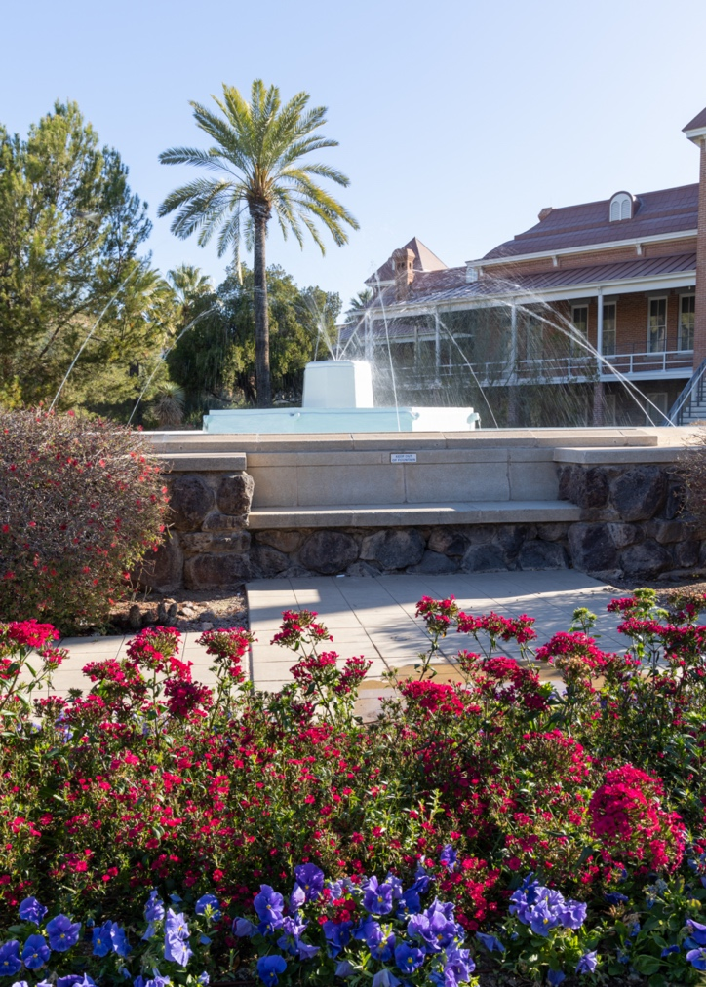
Health and Community Services
Identify any existing or needed health or community-based services:
Healthcare Services: Eligibility / Enrollment / Contact Information
Community Services: Eligibility / Enrollment / Contact Information

Slide 13
Overall Assessment

Slide 14
Advance Care Planning
Parents avoiding discussion.
Palliative care should be offered throughout the entire treatment course- it is NOT an option of last resort, it is woven throughout, every time you treat a symptom (pain, nausea from chemo/radiation, constipation from opioids) and every time you talk about what patient’s goals of care are. Hospice would be at end of case, and in kids, there is concurrent care provision, so could even be on hospice at the same time as receiving cure directed therapy (this is unique to peds).
Palliative care/hospice in pediatrics is the same philosophy but there tends to be more hesitancy in the pediatric population for all areas-providers, parents, patient, etc.
NP role is to help identify when the patient is ready to transition to palliative/hospice and provide the appropriate referrals.
NP role is to educate the adolescent and family about palliative care and how it can help the patient and family at this stage in the diagnosis. Palliative care/hospice does not mean you are dying tomorrow and that your physical and mental needs will not be met.

Slide 15
Advance Care Planning
Advance Care Planning
What matters most to the patient now?
Important to address patient and family. Patient wants to go back to his pre-diagnosis life, go to school, play soccer. Parents hope for a cure and keep optimism about prognosis. Young people are often brave and just want to be treated like a normal kid. Parents are struggling with acceptance of diagnosis.
What do they want their health for?

Slide 16
Next Steps / Outcomes
What happens next:
Shared decision making for treatment- surgery/chemo/radiation and eventually decision on palliative care and hospice.
Details about family conversations:
Parents concerned about finances and insurance coverage also fearful about their immigration status.
What happens at, or near, death of patient:
What support does family need before and after death of patient:

Slide 17
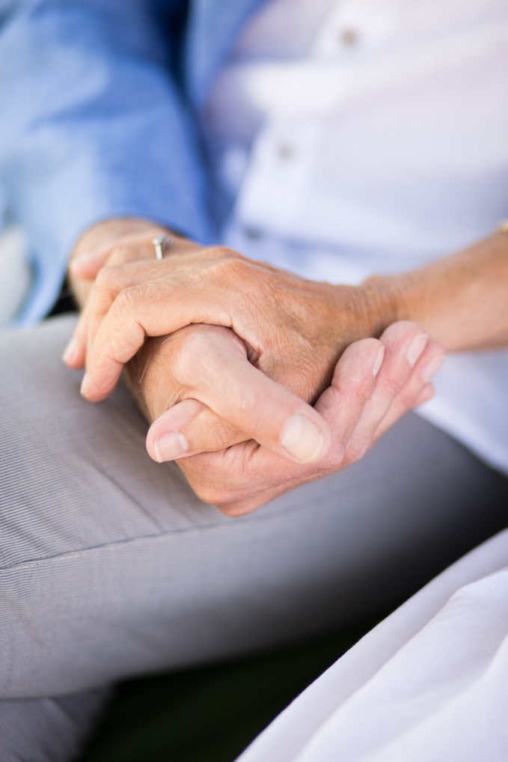
Challenging Conversations
Best Case / Worst Case:
Risk / Benefit of Intervention:

Slide 18
Interprofessional Focus
What role do other disciplines play in this patient’s end-of-life care?
MDs (attending-primary care team-oncology and palliative care/resident/medical student), Nurse, Social Worker, Pharmacist, Case Worker
Who can help you provide the best care and honor the patient’s wishes?
Truth telling to patient- family may refuse telling patient that treatment is not effective any more.

Slide 19
Interprofessional Focus
How will you approach utilizing a team approach to providing care?
Beyond referrals, how will you become comfortable with going outside your comfort zone?
Are there any integrative, traditional, or complementary therapies that will help the patient at this stage or later?

Slide 20
Questions to Consider
?
Can you identify any overarching bias?
Can you identify any possible assumptions one might make about this patient?
What information about this patient might inform public policy or regulatory action?

Slide 21
Teaching Points
Check boxes to indicate 3-5 teaching points:
x
ADVANCE CARE DIRECTIVE
Teaching point: Each health science student should be
knowledgeable about advance care directives; and
be able to communicate and engage patients / families in advance care planning across settings and across the lifespan.
x
PALLIATIVE CARE AND HOSPICE
Teaching point: Each health science student should be
knowledgeable about palliative care and hospice; and
be able to effectively communicate this information to patients / families.

Slide 22
Teaching Points
Teaching Points
Check boxes to indicate 3-5 teaching points:
x
CULTURAL HUMILITY
Teaching point: Each health science student should be
knowledgeable about cultural considerations in the care of patients and families, and
be able to effectively communicate with humility, curiosity, care, respect, and dignity.
x
COMMUNITY RESOURCES
Teaching point: Each health science student should be
knowledgeable about community resources to support serious illness and end-of-life care, and
be able to effectively connect patients/families with these resources.

Slide 23
Teaching Points
Check boxes to indicate 3-5 teaching points:
x
CHALLENGING CONVERSATIONS
Teaching point: Each health science student should be
knowledgeable about how to deliver “best case / worst case” and
be able to effectively conduct challenging conversations with patients / families (including how to discuss risk / benefits of interventions).
x
INTERPROFESSIONAL CARE
Teaching point: Each health science student should be
knowledgeable about the role of team members & benefits of team-based care and
be able to effectively work with team members in the care of patients / families with serious illness or at the end of life.

Slide 24
Resources
https://www.raisingarizonakids.com/pediatricyoung-adult-cancer-resources/
https://www.candlelightersaz.org/
https://www.amandahope.org/resources

Slide 25
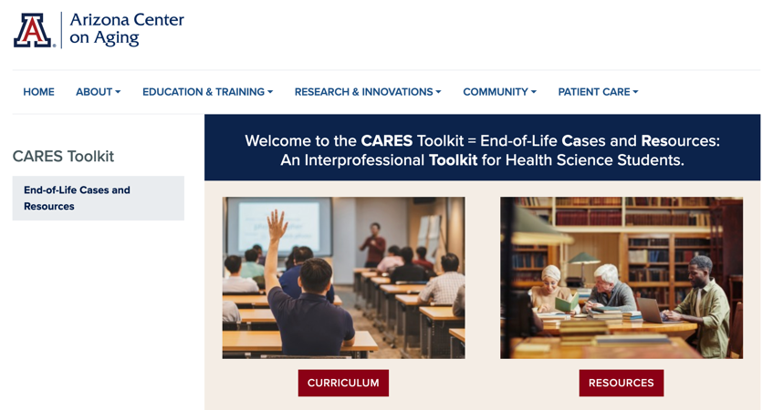
Thank
you
Please visit the Center on Aging
aging.arizona.edu
for more information on the CARES Toolkit
and other end-of-life resources
This project was funded by a grant from the David and Lura Lovell Foundation

