Slide 1
The CARES Toolkit
End-of-Life Cases and Resources:
An Interprofessional Toolkit for Health Science Students
Case Name: 54-Year-Old Native American Woman Veteran Living with ALS — Scenario 2
College:
Course:
Instructor:

Slide 2
Learning Topics
1. Advance Care Planning: Engage patients/families in advance care planning across settings and across the lifespan
2. Discuss palliative care and hospice options
3. Symptom Improvement / Enhancing Quality of Life
4. Describe roles of interprofessional healthcare team members in helping patients and family members with advance care planning
Medication management that should be considered for end-of-life care for this patient and the role of pharmacist in care.
5. Identifying resources on health insurance eligibility for patients with advanced ALS
6. Identifying available services/support for patient and caretaker stressors beyond heath status (e.g., financial needs, family health insurance)

Slide 3
Specific Communication / Conversation Skills
1. Communication with cultural awareness and humility
2. Communicating with a patient who is a healthcare professional
3. Difficult conversations under difficulty circumstances when patient's wishes are not documented, and family members are not in agreement

Slide 4
Interprofessional Team Members
Team Members/Role:
Palliative care physician
Palliative care pharmacist
Palliative care nurse
Public health professional
Social worker
Psychologist
Nutritionist
Patient
Family

Slide 5
Case Summary
Setting of Encounter: Interprofessional Clinic.
You are a member of an interprofessional team, consisting of a physician, pharmacists, nurse practitioners, a psychologist, social workers, registered dieticians, and occupational therapists, that provides Home-Based Primary Care (HBPC), a service offered by the Veteran Affairs (VA). The team provides at home care visits as part of the HBPC service to homebound patients, and there are a few patients with Amyotrophic Lateral Sclerosis (ALS) cared for by the HBPC team.
Context: Today you and a HBPC physician have a home visit with Ayita Bitsilly – a retired Air Force pilot who was diagnosis with ALS 3 years ago, to assess and manage her pharmacotherapy needs. Also present at the visit is Mr. Jacy Bitsilly who expresses his concern for his wife’s wellbeing. Over the past few years since his wife’s diagnosis, he has been the sole caregiver. He expresses his concern for the progression of the disease. He notes that Ayita’s pain has been getting worse and that the morphine has not been lasting as long as it used to. He explains that in the past few weeks, Ayita has had increased difficulty walking and trips quite often. She prefers to not use her walker and he has caught her from falling several times. He has also noticed that she has had more difficulty feeding herself.
Reason for Encounter: Palliative care pharmacologic management / uncontrolled pain, mild upper extremity weakness, moderate-severe lower extremity weakness, and progression of disease.

Slide 6
Demographics
Name: Ayita Bitsilly
Gender: Female
Age: 54-years-old
Ethnicity: Native American (Navajo)
Living Situation: She is married and has a 14-year-old male child. She has 4 younger siblings who live on the reservation.
Occupation: 4th grade schoolteacher after retiring from the USAF. No longer employed as of 2019.
Insurance Coverage: Retired military and has TRICARE for Life health insurance coverage.

Slide 7
Demographics
Family / Caregiver Issues: Ayita lives with her husband Jacy and 14-year-old son Hakan in Tucson. She retired from the USAF in 2012 and has VA health care. Mr. Jacy Bitsilly expresses his concern for his wife’s wellbeing. Over the past few years since his wife’s diagnosis, he has been the sole caregiver.
Social Economic Status: Unable to work, has disability coverage and TRICARE for Life insurance.
Social Determinants of Health: Economically stable, limited social interactions/context.
Social / Mental Health Wellbeing: She has uncontrolled pain, mild upper extremity weakness, moderate-severe lower extremity weakness, and is worried about the progression of her disease and how much time she will have to spend time with her son.
Religious / Spiritual Considerations: Christianity with traditional Navajo practices.
Cultural Beliefs / Perspectives: Traditional Navajo practices.

Slide 8
Patient Health Information
History of Present Illness: Retired Lieutenant Ayita Bitsilly is a 54-year-old female Veteran with a history of diabetes and seen today with severe (9 out of 10) pain that is not well controlled with PRN morphine, worsening lower extremity weakness who often trips (no falls), and ALS disease progression.
Illness Course / Treatment Information: She was diagnosed with ALS 3 years ago, shortly after retiring from the United States Airforce as a pilot. Her ALS has had a relatively slow progression but recently, over the past few weeks, she has been experiencing worsening of symptoms. She has increased difficulty walking, muscle spasms and has been tripping more frequently. Her husband expresses his concern for Ayita’s physical decline.

Slide 9
Patient Health Information
Physical Exam (from physician’s home visit the day before):
Vital Signs:
Ht: 5ft 4in; Wt: 154 lbs;
Pulse: 92;
BP: 140/73;
Respiratory Rate: 18
General: Female in pain, lying in a hospital bed in her living room. She answers questions and nods or shakes her head for yes/no answers. She is in clear pain as she is gently examined.
Neurologic: Alert, oriented to person, place, and time. Her reflexes are brisk, with several beats of clonus in her upper extremities. She has a Babinski sign on the right foot, and a Hoffman’s sign in her right thumb and index finger.
Musculoskeletal: Upper and lower extremity muscles show atrophy and some muscle fasciculations in her thighs and calves.
Skin: No decubitus ulcers nor evidence of skin breakdown.
Lungs: Shallow respirations.
Heart: Tachycardia at 92, no murmurs.
Abdomen: Bowel sounds are present. No masses.
Genital: Declined.
Rectal: Declined. The stool is hemoccult negative.

Slide 10
Patient Health Information
Medications / Treatments: Morphine sulfate liquid 10mg/ml – 3 ml every 8 hours as needed for pain. Metformin ER 1000mg twice daily. Insulin Lantus U-100 35 units in the evening.
Allergies / Intolerances: No known drug allergies
Tobacco, Alcohol or Substance Use: Tobacco: none; alcohol: 2-3 drinks a week.
Review of Systems: Muscle spasms in upper and lower extremities. Reports progressive loss of function - difficulty walking, feeding herself, and performing activities of daily living.
Past Medical History: Type 2 Diabetes
Family History: No history of ALS in the family. Her mother passed away at the age of 76 of a heart attack and had a history of hypertension and diabetes. Her father is 83 with a history of diabetes and atrial fibrillation on Eliquis.

Slide 11
Health and Community Services
Identify any existing or needed health or community-based services:
Healthcare Services: Eligibility / Enrollment / Contact Information
Students should (1) know about home and community-based care, palliative
care, hospice and (2) effectively communicate this information to
patients/families.
Community Services: Eligibility / Enrollment / Contact Information
Students should: (1) know about community resources to support serious illness
and end of life care, (2) help a patient, family member, caregiver navigate their
eligibility for coverage (Medicaid, Medicare) and services (3) effectively connect
patients / families with these resources (eligibility, enrollment, navigation).

Slide 12
Overall Assessment
Uncontrolled severe chronic pain, muscle spasms and progression of the disease/functional decline in a patient with ALS.

Slide 13
Advance Care Planning
Advance directives signed by patient indicates:
Comfort measures
Do not hospitalize, intubate, or place a feeding tube.

Slide 14
Advance Care Planning
Advance Care Planning
What matters most to the patient now?
She is in severe pain and has progressing symptoms of upper/lower extremity weakness; wants adequate pain relief, spasm control, and some help with slowing the disease progression and loss of functionality.
What do they want their health for?
She is in severe pain and has progressing symptoms of upper/lower extremity weakness; wants adequate pain relief, spasm control, and some help with slowing the disease progression and loss of functionality.

Slide 15
Next Steps / Outcomes
What happens next:
What can be done to better control patient’s pain and spasms?
What can be done to help slow progression of disease?
What health insurance coverage might patient be eligible for in her current condition?
What health/caretaking services might patient be eligible for that he can receive at home?
What can be done about her financial situation – affordable care, medications, respite care, accrued student loan debt, mortgage? Who will assume her obligations?
Details about family conversations:
What more do you need to know about her current directives, or if she wishes to modify them?
What matters most to the patient now?
Students should (1) know about advance care directives and forms; and (2) communicate and engage patients, families, partners - in advance care planning across settings and across the lifespan.
What happens at, or near, death of patient:
What support does family need before and after death of patient:

Slide 16
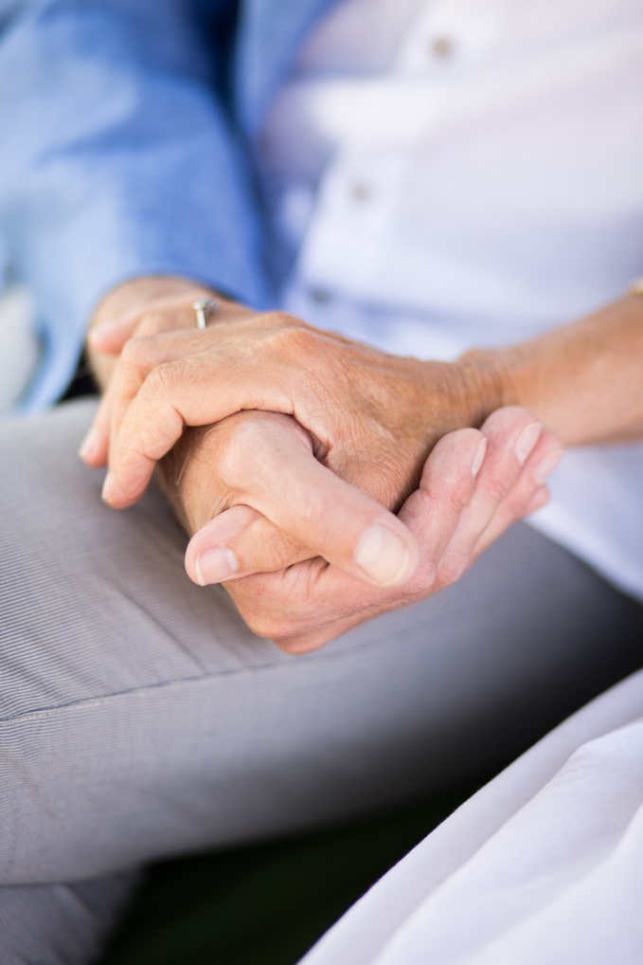
Challenging Conversations
Best Case / Worst Case:
Risk / Benefit of Intervention:

Slide 17
Interprofessional Focus
What role do other disciplines play in this patient’s end-of-life care?
Students should (1) know about the role of team members & benefits of team-based care such as for respite care, physical therapy, pharmacologic management of pain / uncomfortable symptoms at the end of life, and (2) effectively work with team members in the care of patients / families with serious illness or at the end of life.
Who can help you provide the best care and honor the patient’s wishes?

Slide 18
Interprofessional Focus
How will you approach utilizing a team approach to providing care?
Beyond referrals, how will you become comfortable with going outside your comfort zone?
Are there any integrative, traditional, or complementary therapies that will help the patient at this stage or later?

Slide 19
Questions to Consider
?
Can you identify any overarching bias?
Can you identify any possible assumptions one might make about this patient?
What information about this patient might inform public policy or regulatory action?

Slide 20
Teaching Points
Check boxes to indicate 3-5 teaching points:
x
ADVANCE CARE DIRECTIVE
Teaching point: Each health science student should be
knowledgeable about advance care directives; and
be able to communicate and engage patients / families in advance care planning across settings and across the lifespan.
x
PALLIATIVE CARE AND HOSPICE
Teaching point: Each health science student should be
knowledgeable about palliative care and hospice; and
be able to effectively communicate this information to patients / families.

Slide 21
Teaching Points
Teaching Points
Check boxes to indicate 3-5 teaching points:
x
CULTURAL HUMILITY
Teaching point: Each health science student should be
knowledgeable about cultural considerations in the care of patients and families, and
be able to effectively communicate with humility, curiosity, care, respect, and dignity.
x
COMMUNITY RESOURCES
Teaching point: Each health science student should be
knowledgeable about community resources to support serious illness and end-of-life care, and
be able to effectively connect patients/families with these resources.

Slide 22
Teaching Points
Check boxes to indicate 3-5 teaching points:
x
CHALLENGING CONVERSATIONS
Teaching point: Each health science student should be
knowledgeable about how to deliver “best case / worst case” and
be able to effectively conduct challenging conversations with patients / families (including how to discuss risk / benefits of interventions).
x
INTERPROFESSIONAL CARE
Teaching point: Each health science student should be
knowledgeable about the role of team members & benefits of team-based care and
be able to effectively work with team members in the care of patients / families with serious illness or at the end of life.

Slide 23
Resources - Organizations that support ALS patients and caregivers
https://www.cdc.gov/als/OrganizationsthatSupportPALS.html
National ALS Registry Partners:
ALS Association:external icon the largest, national non-profit organization dedicated to ALS by providing assistance for people with ALS through a nationwide network of chapters, coordinating multidisciplinary care through certified clinical care centers.
MDA ALS:external icon supports muscular dystrophy and related life-threatening diseases such as ALS through its national network of clinics.
Les Turner ALS Foundation:external icon provides comprehensive ALS care and support services in the Chicagoland area and at Northwestern Medicine.
Northeast Amyotrophic Lateral Sclerosis Consortium (NEALS):external icon supports ALS research and clinical trials through its network of ALS partners.
National Institutes of Health (NIH):external icon National Institute of Aging (NIA) partners with the Registry to provide research support in the area of genetic analyses of specimens from the National ALS Biorepository.
CReATe:external icon goal of the Clinical Research in ALS and Related Disorders for Therapeutic Development (CReATe) Consortium is to advance therapeutic development for sporadic and familial forms of amyotrophic lateral sclerosis (ALS).

Slide 24
Resources - Organizations that support ALS patients and caregivers
ALS Informational Sites:
ALS Clinical Trials:external icon find ALS clinical trials approved by the Food and Drug Administration (FDA).
I AM ALS:external icon patient-led community that provides critical support and resources to patients, caregivers and loved ones.
Financial and Medication Assistance for ALS: https://www.needymeds.org/copay_diseases.taf?_function=summary&disease_id=151&disease_eng=Amyotrophic%20Lateral%20Sclerosis%20%28ALS%29&dx=18&drp=als

Slide 25
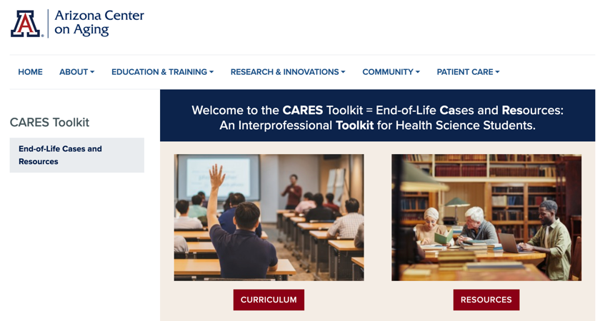
Thank
you
Please visit the Center on Aging
aging.arizona.edu
for more information on the CARES Toolkit
and other end-of-life resources
This project was funded by a grant from the David and Lura Lovell Foundation

