Slide 1
The CARES Toolkit
End-of-Life Cases and Resources:
An Interprofessional Toolkit for Health Science Students
Case Name: 79-Year-Old Asian-American Man Living with Dementia & Polypharmacy — Scenario 1
College:
Course:
Instructor:

Slide 2
Learning Topics
1. Advance Care Planning: Engage patients/families in advance care planning across settings and across the lifespan
2. Discuss opportunities for end-of-life conversations
3. Describe roles of interprofessional healthcare team members in helping patients and family members with advance care planning

Slide 3
Specific Communication / Conversation Skills
1. Communication with cultural awareness and humility
2. Communicating when there are language barriers
3. Difficult conversations under difficulty circumstances when patient's wishes are not documented, and family members are not in agreement

Slide 4
Interprofessional Team Members
Team Members/Role:
Primary care physician (Geriatrician)
Geriatric pharmacist
Primary care nurse
Medical assistant
Social worker
Neurologist
Family
Pastor

Slide 5
Case Summary
*NOTE: This case has two encounters
Setting of Encounter #1: Community-based Interprofessional Geriatrics Clinic. Older patient comes with his wife to the Geriatrics Pharmacy Clinic for an initial visit. The patient lives with his wife and has a daughter in Atlanta. No Medical Power of Attorney (MPOA) has been designated but assumes that his wife would be the MPOA. He retired from Raytheon with financial resources. Christian beliefs (shared by family) and involved in local Korean church community. No “do not resuscitate” (DNR) status.
Context of Encounter #1: The patient’s physical and cognitive functions - activities of daily living (ADLs) and instrumental activities of daily living (IADLs) - have declined due to Parkinson’s disease, dementia, diabetes, hypertension, dyslipidemia, chronic obstructive pulmonary disease (COPD) and osteoarthritis.
Patient’s chief complaint is polypharmacy and was referred to the Geriatrics Pharmacy Clinic by the primary care provider, who is a geriatrician. The wife organizes the patient’s medications and is concerned about the best time for taking all his prescribed medications and which are okay to take together at the same time. They also use multiple vitamins and supplements for holistic care and health maintenance. Currently he takes the medications 5 times a day, sometimes has trouble with correct use of inhalers, and needs a reminder from his wife to ensure adherence. He was admitted to the hospital twice last year due to COPD exacerbations.

Slide 6
Case Summary
Reason for Encounter #1: To meet with a clinical pharmacist about polypharmacy use, medication management, and medication adherence per referral by the primary care provider. Polypharmacy use includes prescription medications, over-the-counter (OTC) agents, vitamin supplements, and herbal products. Patient has a complex regimen (taking medications more than twice daily and/or 12 or more doses per day), problems with correct use of inhalers and questionable medication adherence. Hospitalization x 2 in last year due to COPD exacerbations.
*Opportunity to assess cognition and to discuss goals of care, what matters most.

Slide 7
Case Summary
Setting of Encounter #2: Patient returns to the Geriatrics Pharmacy Clinic 8 weeks later for follow up.
Context of Encounter #2: Patient has continued decline in cognition and physical function. Wife and daughter are concerned.
Reason for Encounter #2: Follow up visit to assess medication management and adherence at home; any need to improve chronic disease management, further simplification of medications/OTCs/vitamins/herbals, and adherence intervention.
*Opportunity to start advance care planning.

Slide 8
Demographics
Gender: Male
Age: 79-years-old
Ethnicity: Asian-American. Originally from South Korea – moved to the US at age 24 years to attend graduate school. He returned to South Korea when he was 30 to get married and brought his wife to the US afterward, and they have one daughter. He has a dual citizenship in South Korea and US.
Living Situation: Lives in Oro Valley in a large single-family home with his wife. Their daughter lives in Atlanta with her husband, who is White, and 3 teenagers (1 daughter and 2 sons). The patient and his wife are close with their daughter but have not seen her or the grandchildren for a couple of years due to the COVID-19 pandemic. They communicate via weekly phone calls and Kakao Talk app on their smartphones.
Patient and wife speak Korean in the home. They speak Konglish (Korean and English) with their daughter and speak English with their son-in-law and grandchildren. The patient and wife feel safe in their home but are thinking about downsizing and moving into a senior community because it is becoming burdensome to take care of the house and the yard.

Slide 9
Demographics
Occupation: Retired - was an engineer at Raytheon
Insurance Coverage: Medicare and Blue Cross Blue Shield
Family / Caregiver Issues: Married with one adult child. Wife cares for patient and daughter when she comes to visit, but unable to visit for 2 years due to the pandemic.
Social Economic Status: Social security check and retirement benefits
Social Determinants of Health: Finished Master’s degree in engineering. Wife cares for his daily needs, drives him to medical and other appointments, and purchases food and purchases meals. She also purchases and organizes medicines for patient.

Slide 10
Demographics
Social / Mental Health Wellbeing: Does light yardwork
Religious / Spiritual Considerations: Christian, was active in a local Korean church until the COVID-19 shut down, then has not returned in person. Watches the virtual service on some Sundays.
Cultural Beliefs / Perspectives: Believes diet and exercise is most important, but has limited functional capacity and breathing difficulties for vigorous exercise now.

Slide 11
Patient Health Information
History of Present Illness:
Encounter #1: 79-year-old Asian-American man with multiple chronic conditions including to Parkinson’s disease, dementia, diabetes, hypertension, dyslipidemia, chronic obstructive pulmonary disease (COPD) and osteoarthritis.
Encounter #2: Patient is in similar physical and cognitive status, but his breathing and medication adherence have improved greatly with correct use of inhalers and less burdensome medication organization and schedule.

Slide 12
Patient Health Information
Illness Course / Treatment Information:
Encounter #1: He has been prescribed 10 prescription medications, takes several vitamins as supplement, and herbal products. The patient speaks Korean and English. He complains of difficulty using inhalers for his COPD and has been hospitalized twice in the last year due to exacerbations.
The wife says she tries to organize his medications for him to take 5 times a day, but sometimes patient misses taking medications due to doing light yardwork outside or simply forgetting. The patient is independent in ADLs, dependent in IADLS - wife manages their finances, drives patient to medical appointments, prepares their meals, and maintains living areas of the home, though patient enjoys light yardwork. On Mini-Mental State Examination (MMSE) = 15. Patient and wife are not ready to discuss advance care planning.
Encounter #2: Wife reports he is taking medications twice daily and uses inhalers on time with having to use the rescue inhaler once in the last week when he went outside to do yardwork. He is ready to decrease vitamin and supplement use per recommendations from last visit. On exam, MMSE = 15. He and wife are open to discussing advance care planning now.

Slide 13
Patient Health Information
Physical Exam:
Looks stated age. Attentive and can answer most questions, except medication-related questions (wife answers). Some spontaneous conversation. MMSE = 15
Patient is 5’6”, weight = 141 lb, BMI = 22.7 (close to the upper limit of healthy range for Asian Americans)
Fair dentition, moderate hearing loss
CN 2-12 Normal
Thyroid: WNL
CVS: normal capillary refill hands and feet.
BP=134/72, HR: 74 and regular, normal S1, S2, no extra sounds or murmurs.
Resp: RR=12, no wheezes but slight crackles throughout.
GI: unremarkable
PPP: able to use all limbs, no swelling, no bruising. Gait stable and can walk.
Skin intact.

Slide 14
Patient Health Information
Medications / Treatments:
Prescriptions – Albuterol inhaler, Carbidopa-levodopa, Donepezil, Fluticasone/Vilanterol inhaler, Hydrochlorothiazide, Lisinopril, Metformin, Rosuvastatin, Sitagliptin, Tiotropium handihaler.
OTC products/vitamin supplements – Aspirin, Calcium, Fish Oil, Multivitamin (Senior formula), Naproxen, B-Complex, Vitamin D, Zinc.
Herbal agents – Echinacea, Ginger root, Ginkgo biloba, Glucosamine + Chondroitin, Melatonin.
Allergies / Intolerances: No known allergies
Tobacco, Alcohol or Substance Use: No tobacco currently (used to smoke but quit 13 years ago when diagnosed with COPD); drinks alcohol every evening and more often on weekends; no other substance use.
Review of Systems: Colonoscopy and prostate exam – up to date and no positive findings; Last blood work 1 year ago. Immunizations – up to date.

Slide 15
Patient Health Information
Past Medical History: Parkinson’s disease diagnosed 3 years ago – symptoms controlled on medications; Dementia – unsure if Parkinson’s disease or Alzheimer’s disease in origin; Diabetes type 2 – diagnosed 10 years ago, controlled on medications; Hypertension – diagnosed 10 years ago and blood pressure high at first visit, likely due to nonadherence to medications; Dyslipidemia – diagnosed 5 years ago, nonadherence to a statin medication at first visit; COPD – diagnosed 13 years ago (former smoker), nonadherence to inhalers with inadequate technique at first visit; Osteoarthritis – was using OTC nonsteroidal anti-inflammatory drugs at first visit; Hard of hearing – moderate.
Family History: Unknown family medical history.
The patient lives with his wife in Tucson and has a daughter in Atlanta, who has a husband and 3 teenage children (1 in college and 2 in high school).

Slide 16
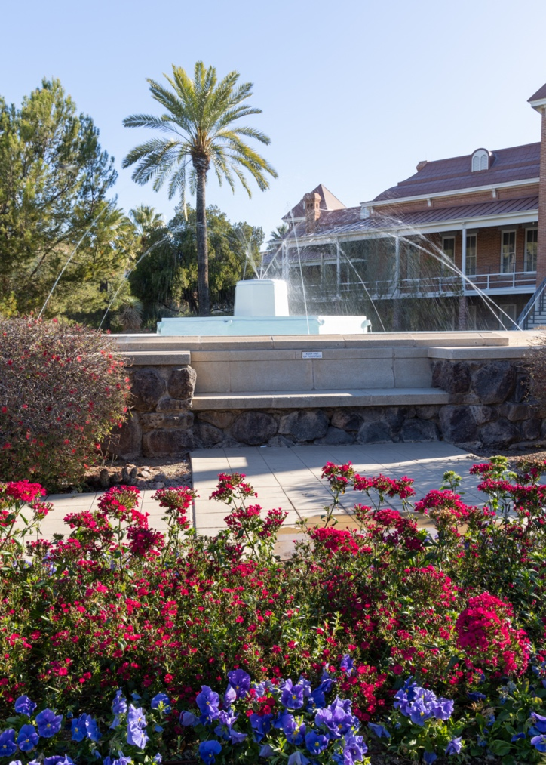
Health and Community Services
Identify any existing or needed health or community-based services:
Healthcare Services: Eligibility / Enrollment / Contact Information
None received.
Community Services: Eligibility / Enrollment / Contact Information
None received, may need new services, if unable to downsize home – independent senior living option might be ideal.
Students should:
(1) know about community resources to support serious illness and end of life care,
(2) help a patient, family member, caregiver navigate their eligibility for coverage (Medicaid, Medicare) and services, and (3) effectively connect patients / families with these resources (eligibility, enrollment, navigation).

Slide 17
Overall Assessment
Encounter #1: The patient is an Asian-American older male with moderate dementia, may be Parkinson’s disease or Alzheimer’s disease related dementia, MMSE = 15. Using polypharmacy with complex regimen that is difficult for wife to manage – medication nonadherence noted and past hospitalization due to COPD exacerbations. Optimal care would include (1) medication management – simplifying medication regimen to enable wife’s organization, switching potentially inappropriate medications to safer agents for this older patient, increasing medication adherence, and minimizing adverse effects/events; (2) chronic disease management, particularly COPD to prevent further hospitalization; (3) providing support to the patient and wife, optimizing safety and quality of life for both, and (4) discussing what matters most and advance care planning. Patient and wife are willing to take medication management recommendations and steps, but not open to discussing advance care planning at this visit. Willing to return for a follow up visit for polypharmacy and chronic disease management in 8 weeks.
Encounter #2: The patient and wife return with medication management strategies implemented and improved adherence to medications. He is willing to streamline his vitamins and herbal use today to further simplify his medication regimen to lessen wife’s organization and management burden. They are both ready and willing to discuss advance care planning at this time also. They are open to reviewing the Arizona Advance Health Care Directives booklet and bring questions to the next visit.

Slide 18
Advance Care Planning
None. Patient assumes wife will decide, but they have differing opinions about end-of-life interventions. No DNR.
Encounter #1, MMSE = 15: He can make end-of-life decisions at this time. Not open to conversations about advance care planning.
Encounter #2, MMSE = 15: Same cognitive status. Patient and wife open to conversations about advance care planning. Their opinions differ on chest compressions and intubation. Wife wants patient to live as long as possible, no matter his state. The patient wants cardiopulmonary resuscitation (CPR) but not breathing or feeding tubes.

Slide 19
Advance Care Planning
Advance Care Planning
What matters most to the patient now?
The patient shared that what matters most to him is to continue living independently with his wife and attending his grandchildren’s high school and college graduations.
What do they want their health for?
Encounter #1: Continue to live independently with his wife and attend his grandchildren’s high school and college graduations. Not open to discussing end-of-life plans; wishes to feel healthy first.
Encounter #2: Patient returns to the Geriatrics Pharmacy Clinic 8 weeks later for follow up of his medication management and inhaler use. Better medication adherence and no hospitalization since the last visit. He and wife are more open now to thinking about and discussing their end-of-life plans.

Slide 20
Next Steps / Outcomes
What happens next:
What is most important at this stage?
How do you document what matters most to the patient/wife and goals of care?
What questions do you anticipate the patient/wife having after their review of the Arizona Advance Health Care Directives booklet?
Details about family conversations:
Students should: 1) know about advance care directives and forms, 2) communicate and engage patients, families, care partners in advance care planning across settings and across lifespan.
What happens at, or near, death of patient:
What support does family need before and after death of patient:
Patient's wishes and advance care directives information
Patient's will and asset management plan
National and community resources

Slide 21
Challenging Conversations
Best Case / Worst Case:
Risk / Benefit of Intervention:

Slide 22
Interprofessional Focus
What role do other disciplines play in this patient’s end-of-life care?
Students should:
(1) know about the role of team members & benefits of team-based care such as for respite care, physical therapy, pharmacologic management of pain / uncomfortable symptoms at the end of life
(2) effectively work with team members in the care of patients / families with serious illness or at the end of life
Who can help you provide the best care and honor the patient’s wishes?

Slide 23
Interprofessional Focus
How will you approach utilizing a team approach to providing care?
Beyond referrals, how will you become comfortable with going outside your comfort zone?
Are there any integrative, traditional, or complementary therapies that will help the patient at this stage or later?

Slide 24
Questions to Consider
?
Can you identify any overarching bias?
Can you identify any possible assumptions one might make about this patient?
What information about this patient might inform public policy or regulatory action?

Slide 25
Teaching Points
Check boxes to indicate 3-5 teaching points:
x
ADVANCE CARE DIRECTIVE
Teaching point: Each health science student should be
knowledgeable about advance care directives; and
be able to communicate and engage patients / families in advance care planning across settings and across the lifespan.
x
PALLIATIVE CARE AND HOSPICE
Teaching point: Each health science student should be
knowledgeable about palliative care and hospice; and
be able to effectively communicate this information to patients / families.

Slide 26
Teaching Points
Teaching Points
Check boxes to indicate 3-5 teaching points:
x
CULTURAL HUMILITY
Teaching point: Each health science student should be
knowledgeable about cultural considerations in the care of patients and families, and
be able to effectively communicate with humility, curiosity, care, respect, and dignity.
x
COMMUNITY RESOURCES
Teaching point: Each health science student should be
knowledgeable about community resources to support serious illness and end-of-life care, and
be able to effectively connect patients/families with these resources.

Slide 27
Teaching Points
Check boxes to indicate 3-5 teaching points:
x
CHALLENGING CONVERSATIONS
Teaching point: Each health science student should be
knowledgeable about how to deliver “best case / worst case” and
be able to effectively conduct challenging conversations with patients / families (including how to discuss risk / benefits of interventions).
x
INTERPROFESSIONAL CARE
Teaching point: Each health science student should be
knowledgeable about the role of team members & benefits of team-based care and
be able to effectively work with team members in the care of patients / families with serious illness or at the end of life.

Slide 28
Resources
Advance Directives for Medical Decisions: Zagaria MAE. US Pharm. 2012;37(7):20-22.
https://www.uspharmacist.com/article/advance-directives-for-medical-decisions
Pharmacist care planning services: What matters most
Breault et al. 2021 https://doi.org/10.1177/17151635211004631
Exploring the Expanded Role of Pharmacists in Advance Care Planning: Ma JD, et al. JCO Oncol Pract 2021;17:102-106.
https://ascopubs.org/doi/full/10.1200/OP.20.00684
Project Implicit: Implicit Bias Tests.url
Culturally Diverse Communities and Palliative and End-of-Life Care: https://www.apa.org/pi/aging/programs/eol/end-of-life-diversity
Arizona PREPARE Advance Directive: PREPAREforYourCare.org
Arizona Advance Directive (Medical POA & Living Will) - https://eforms.com/advance-directive/az/
El Rio Health - Monthly Advance Care Planning Workshops
- What is Advance Care Planning?
- Why should we plan for our future healthcare?
- Who will speak for me when I cannot speak?
https://www.elrio.org/advancecareplanning/

Slide 29
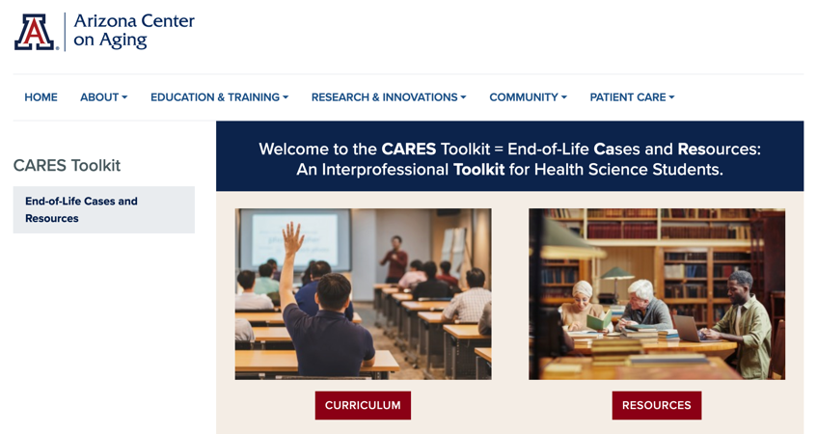
Thank
you
Please visit the Center on Aging
aging.arizona.edu
for more information on the CARES Toolkit
and other end-of-life resources
This project was funded by a grant from the David and Lura Lovell Foundation

