Slide 1
The CARES Toolkit
End-of-Life Cases and Resources:
An Interprofessional Toolkit for Health Science Students
Case Name: 30-Year-Old White Man Living with ALS
College:
Course:
Instructor:

Slide 2
Learning Topics
1. Build healthy public policy
2. Create supportive environments
3. Strengthen community action
4. Develop personal skills
5. Reorient health services

Slide 3
Specific Communication / Conversation Skills
Listening
Conciseness
Body language
Confidence
Open-mindedness
Respect
Using the correct medium

Slide 4
Interprofessional Team Members
Team Members/Role: N/A

Slide 5
Case Summary
Setting of Encounter: Walk to Defeat Amyotrophic Lateral Sclerosis (ALS) event.
Context/Reason for Encounter: Stephen and his parents attend a public event where people gather/walk to honor those with ALS and to visit table exhibitors who provide information related to ALS, including community and health resources, caregiving resources, insurance benefits, and policy/advocacy. Stephen approaches a college of Public Health table that is manned with 3 public health students.

Slide 6
Demographics
Name: Stephen Jones, MD
Gender: Male (he, him)
Age: 30-years-old
Ethnicity: White
Living Situation: Stephen lives alone. His parents live close by. The family lives in a mid-to-large size rural community.
Occupation: Family physician, newly hired, but will be unable to work soon.
Insurance Coverage: Has insurance through his employment.

Slide 7
Demographics
Family / Caregiver Issues:
Social Economic Status:
Social Determinants of Health:
Social / Mental Health Wellbeing:
Religious / Spiritual Considerations:
Cultural Beliefs / Perspectives:

Slide 8
Health Information
History of Present Illness: Stephen is a 30-year-old male diagnosed with Amyotrophic Lateral Sclerosis (ALS) two months ago, shortly after finishing his residency program.
Illness Course / Treatment Information:
Physical Exam:
Vital Signs: Ht: 6ft 2in; Wt: 135 lbs; Pulse: 95; BP: 120/80; Respiratory Rate xx
General:
Neurologic: alert, oriented to person, place and time.
Musculoskeletal:
Skin: there are no decubitus ulcers nor evidence of skin breakdown
Lungs:
Heart: no murmurs
Abdomen: bowel sounds are present, no masses
Genital:
Rectal: declined, the stool in hemoccult negative

Slide 9
Health Information
Tobacco, Alcohol or Substance Use: None
Past Medical History: No significant past medical history
Family History: He has no children or siblings. No history of ALS in the family. His 58-year-old mother is healthy. His dad is 62 and has heart health issues.

Slide 10
Case Summary
Identify any existing or needed health or community-based services:
Healthcare Services: Eligibility / Enrollment / Contact Information
Stephen and his parents need information on caregiver respite services, support group and Advance Care planning
Community Services: Eligibility / Enrollment / Contact Information

Slide 11
Overall Assessment
Stephen is newly diagnosed with ALS. Family physician, newly hired, but will be unable to work soon.

Slide 12
Advance Care Planning
Stephens signed his current Advance Directives 5 years ago. The directives instruct he only wants comfort measures. He does not want to be hospitalized, intubated, or have a feeding tube. He wishes to die at home.

Slide 13
Advance Care Planning
Advance Care Planning
What matters most to the community member now?
Steven says he is very anxious. He is worried about his declining health and becoming a burden on his parents. He plans to move in with his parents once he can no longer care for himself. He is worried about the day he will no longer be able to feed, clean or dress himself. How will his parents cope with everything the future holds? He is not even sure what his insurance will cover, and when? How sick will he have to be before certain benefits kicks in? How will his parents pay for all the expenses insurance won’t cover? His parents are aging, who is going to take care of them? As their only child that was supposed to be his job. He also worries about his debts - his $250,000 in student loans and $300,000 house mortgage. Will his parents be held responsible for his debt?
Stephen is concerned his current living will is not adequate considering his new diagnosis. What issues/situations should he now be considering?

Slide 14
Advance Care Planning
Advance Care Planning
What do they want their health for?
Stephen knows that the people often die from respiratory failure within 3-5 years after their ALS diagnosis, so he wants to learn as much as he can about the policies and services on how to prepare for the future. He lives in a mid-to-large size rural community and wants to know about available community and health services that can help him and his parents. He also wants to know what state and national policies are in place to help him and others in this position.
”

Slide 15
Next Steps / Outcomes
What happens next:
Details about family conversations:
What happens at, or near, death of patient:
What support does family need before and after death of patient:

Slide 16
Next Steps / Outcomes
Questions to Consider:
What more do you need to know about his current directives, and how can he modify them? Does he need more than a living will? Who does he need to inform about what he wants?
What does Stephen’s health insurance cover? And how does his health status dictate what and when services are available? Who will help him, and his parents, navigate these health benefits?
What home health services might Stephen be eligible for?
What can be done about his financial situation – affordable care, medications, respite care, accrued student loan debt, mortgage? Who will assume his obligations?
What community resource can help his parents? Support groups? Caregiving education?
What policy issues need attention in terms of health professions education costs?

Slide 17
Challenging Conversations
Best Case / Worst Case:
Risk / Benefit of Intervention:

Slide 18
Interprofessional Focus
What role do other disciplines play in this patient’s end-of-life care?
Who can help you provide the best care and honor the patient’s wishes?

Slide 19
Interprofessional Focus
How will you approach utilizing a team approach to providing care?
Beyond referrals, how will you become comfortable with going outside your comfort zone?
Are there any integrative, traditional, or complementary therapies that will help the patient at this stage or later?

Slide 20
Questions to Consider
?
Can you identify any overarching bias?
Can you identify any possible assumptions one might make about this person?
What information about this person might inform public policy or regulatory action?

Slide 21
Teaching Points
Check boxes to indicate 3-5 teaching points:
x
ADVANCE CARE DIRECTIVE
Teaching point: Each health science student should be
knowledgeable about advance care directives; and
be able to communicate and engage patients / families in advance care planning across settings and across the lifespan.
x
PALLIATIVE CARE AND HOSPICE
Teaching point: Each health science student should be
knowledgeable about palliative care and hospice; and
be able to effectively communicate this information to patients / families.

Slide 22
Teaching Points
Teaching Points
Check boxes to indicate 3-5 teaching points:
x
CULTURAL HUMILITY
Teaching point: Each health science student should be
knowledgeable about cultural considerations in the care of patients and families, and
be able to effectively communicate with humility, curiosity, care, respect, and dignity.
x
COMMUNITY RESOURCES
Teaching point: Each health science student should be
knowledgeable about community resources to support serious illness and end-of-life care, and
be able to effectively connect patients/families with these resources.

Slide 23
Teaching Points
Check boxes to indicate 3-5 teaching points:
x
CHALLENGING CONVERSATIONS
Teaching point: Each health science student should be
knowledgeable about how to deliver “best case / worst case” and
be able to effectively conduct challenging conversations with patients / families (including how to discuss risk / benefits of interventions).
x
INTERPROFESSIONAL CARE
Teaching point: Each health science student should be
knowledgeable about the role of team members & benefits of team-based care and
be able to effectively work with team members in the care of patients / families with serious illness or at the end of life.

Slide 24
Resources
ALS Resources
I am ALS https://iamals.org/
ALS Association https://www.als.org/
CDC: Organizations that support ALS patients and caregivers https://www.cdc.gov/als/OrganizationsthatSupportPALS.html
Advance Care Planning
Advanced Care Planning for ALS https://iamals.org/get-help/advanced-care-planning-for-als/
ALS Association: End of Life Planning https://www.als.org/navigating-als/end-of-life-plans
Family Caregiving
ALS Association: Find a support group near you https://www.als.org/local-support/support-groups?f%5B0%5D=support_group_chapter%3A3
ALS Association: Caregiver Support Group Tucson
https://www.als.org/arizona/local-care-services/support-groups/caregiver-support-group-tucson
Arizona Caregiving Coalition (support groups and respite resource) https://azcaregiver.org/
Community Resources for Respite
https://des.az.gov/services/disabilities/developmental-disabilities/community-resources/respite
National Alliance for Caregiving: Caregiving in Rural America - A Report from Easter Seals and the National Alliance for Caregiving https://www.caregiving.org/research/special-populations/

Slide 25
Resources
Health Insurance
How to enroll in Medicare if you have ALS
https://www.medicareinteractive.org/get-answers/medicare-health-coverage-options/original-medicare-enrollment/how-to-enroll-in-medicare-if-you-have-als
Social Security: Benefits for people with disabilities
https://www.ssa.gov/disability/index.htm
SS: Compassionate Allowances Information: ALS
https://secure.ssa.gov/apps10/poms.nsf/lnx/0423022660
Older Adult Resources
USAging - Leaders in aging well at home https://www.usaging.org/
Eldercare Locator - find resources in your community for older adults https://eldercare.acl.gov/Public/Index.aspx
Arizona Area Agencies on Aging (AZ4A) https://az4a.org/
Pima Council on Aging (Area Agency on Aging for Pima County) https://pcoa.org/

Slide 26
Resources
Federal Student Loans
Federal Student Aid https://studentaid.gov/manage-loans/forgiveness-cancellation/death
What Happens to Your Student Loans When You Die? https://www.thebalance.com/student-loans-after-death-4777625
ALS Policy/Legislation
ALS Public Policy Priorities https://www.als.org/advocacy/our-priorities
ALS Legislation https://iamals.org/legislation/
Rural Health Resources
Center for Rural Health Resources www.crh.arizona.edu
List of Arizona's Critical Access Hospitals https://crh.arizona.edu/programs/flex/cahs
List of Arizona's Rural Health Clinics https://crh.arizona.edu/programs/flex/rhcs-list
Arizona Rural Safety Net Map https://crh.arizona.edu/map-room
List of all Federally Qualified Community Health Centers https://www.aachc.org/communityhealthcenters/map/

Slide 27
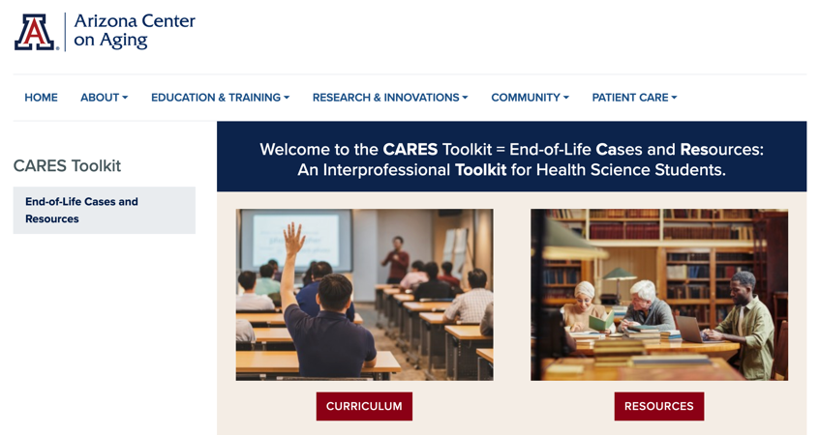
Thank
you
Please visit the Center on Aging
aging.arizona.edu
for more information on the CARES Toolkit
and other end-of-life resources
This project was funded by a grant from the David and Lura Lovell Foundation

