Slide 1
The CARES Toolkit
End-of-Life Cases and Resources:
An Interprofessional Toolkit for Health Science Students
Case Name: 46-Year-Old Woman Living with Metastatic Breast Cancer
College:
Course:
Instructor:

Slide 2
Learning Topics
1. Build healthy public policy
2. Create supportive environments
3. Strengthen community action
4. Develop personal skills
5. Reorient health services

Slide 3
Specific Communication / Conversation Skills
Listening
Conciseness
Body language
Confidence
Open-mindedness
Respect
Using the correct medium

Slide 4
Interprofessional Team Members
Team Members/Role:
The home health nurse plays the major role in providing cares
Physicians are involved with cares and recommendations for next step
Public health interns help find community resources to support the family

Slide 5
Case Summary
*NOTE: This case has two encounter settings and unfolds over time.
Setting of Encounter #1: Primary Care Clinic in A Community Center with public health interns – Leslie was told by oncologist that the tumor is no longer responding to chemotherapy and has metastasized to her lungs.
Context of Encounter #1: Primary Care Clinic in a Community Center – Leslie is independent with all Activities of Daily Living (ADLs) but weak from nausea and inability to eat due to chemotherapy that she has been 100% compliant to the schedule for the last 12 months. She spends a lot of time resting due to her weakness, but it is worth it for her to be well again. She has started to cough and become short of breath, so she is visiting her primary care provider for something for her cough.
Reason for Encounter #1: Stage 4, triple negative breast cancer (TNBC).
Visit to primary care provider to be evaluated for why she has a cough. She is worried that she also has tuberculosis (TB) because her daughter has recently been exposed. This would be terrible because she is already weak from nausea and diarrhea from taking the capecitabine medication. (She has not been told by the oncologist yet that the chemo medication is no longer suppressing the cancer growth, that appointment with the oncologist is next week).

Slide 6
Case Summary
Setting of Encounter #2: Home Visit with public health interns - after Leslie has been informed that the chemotherapy will be stopped, and primary care physician is recommending palliative care.
Context of Encounter #2: Leslie has been informed that the chemotherapy will be stopped, and the cancer has metastasized to her lungs, which is evident in a PET scan. The home health nurse is visiting to see if she can facilitate a palliative care or even a hospice consult.
Reason for Encounter #2: Capecitabine has been stopped and she is at home, feeling better than she has in a long time, since she started it. The home health nurse is stopping by to talk to her about some treatments called palliative that will make her feel even better.

Slide 7
Demographics
Community Member: Leslie Taren
Gender: Female
Age: 46-years-old
Ethnicity: Prefers not to identify
Living Situation: Four (Leslie and 3 children) living in small apartment with 2 bedrooms. The children are ages 4, 10 and 12. English is primary language. Same-sex partner has abandoned family and has not responded to any attempts for contact.
Occupation: Nurse
Insurance Coverage: United Healthcare provided by employer. No short-term disability options.

Slide 8
Demographics
Family / Caregiver Issues: Divorced and estranged from same-sex partner of 15 years. Has 3 children, ages 4 (f), 10 (m) and 12(f).
Social Economic Status: Lower-middle class
Social Determinants of Health: She is living paycheck to paycheck, drives car, steady employment for last 10 years, health literate, educated as LPN and works at long term care facility.
Social / Mental Health Wellbeing: Tries to meditate when has the time.
Religious / Spiritual Considerations: She had Catholic religious beliefs but now feels abandoned by God because of her illness and partner leaving.
Cultural Beliefs / Perspectives:

Slide 9
Health Information
History of Present Illness:
Encounter #1 - Otherwise, healthy, post-menopausal woman palpated a mass in her left breast upon self-exam. Initial examination with fine need aspiration showed a malignant tumor approximately 2 cm tumor with axillary lymph node involvement. Following a left breast mastectomy, the mass was confirmed as triple negative breast cancer (ypT2N1), 4 nodes were positive. Following 12 months of capecitabine oral chemotherapy treatment, patient responded well. Two weeks ago, she presented with a cough and dyspnea. Her daughter had been exposed to TB in one of her friends. She has an appointment with her oncologist next week to discuss the results of a routine imaging showing two small lesions in her left lung that were biopsied and confirmed as metastatic disease from the triple negative breast cancer (TNBC).
Encounter #2 - Leslie is aware of lung lesions and has stopped oral chemo treatments. She is feeling better, nausea is less, and diarrhea has stopped. She gets weary in the afternoon and needs to take a rest, sometime after getting short of breath. The oncologist has ordered a palliative care consult at her home.

Slide 10
Health Information
Illness Course / Treatment Information:
Diagnosis of Stage 4 triple negative breast cancer 2 years ago.12-month course of oral capecitabine and mastectomy. Recently PET scan shows 2 small lesions biopsied as TNBC. Recommend comfort care.
Physical Exam:
Alert, oriented, pleasant female. Appears frail for age. Height 5’9”, weight 115 lbs. Experienced weight recent weight loss. Skin warm and dry. Mucosa of mouth and eyes dry. Head is normocephalic with patches of hair loss. ENT normal. Cardiac assessed with normal rate and rhythm, no murmurs with normal S1 S2 intensity.
Lungs dim in left upper and lower lobes. Right lung clear. Consistent, unproductive cough, no rhonchi upon auscultation. Left chest wall thin, post mastectomy 15 months prior, incision scar well healed. Right breast no masses palpated. Abdomen is soft with hyperactive bowel sounds. Mood and affect appropriate for situation. Expresses concern for her children’s care due to her extreme fatigue.

Slide 11
Health Information
Medications / Treatments: Capecitabine 2-150 mg in morning and 3- 500mg at night; Ativan 10 mg before bed; Zofran 8 mg prn for nausea/vomiting, Imodium as needed for diarrhea; Xanax .5 mg 3 times/day; Zestril 10 mg QD, Vicks Dayquil Cough as needed for cough.
Allergies / Intolerances: No known allergies
Tobacco, Alcohol or Substance Use: No
Review of Systems: Leslie is mobile, however weak due to nausea with vomiting, and diarrhea. She can comfortably move around 2nd floor apartment but risks falling on steps up to apartment due to weakness. Lack of sleep with daytime fatigue. Poor appetite.
Past Medical History: Physically healthy until diagnosed with TNBC. Treated for depression when her partner abandoned her and the children.
Family History: Both parents have died. Father (78-years-old) from melanoma and mother (29-years-old) from automobile accident.

Slide 12
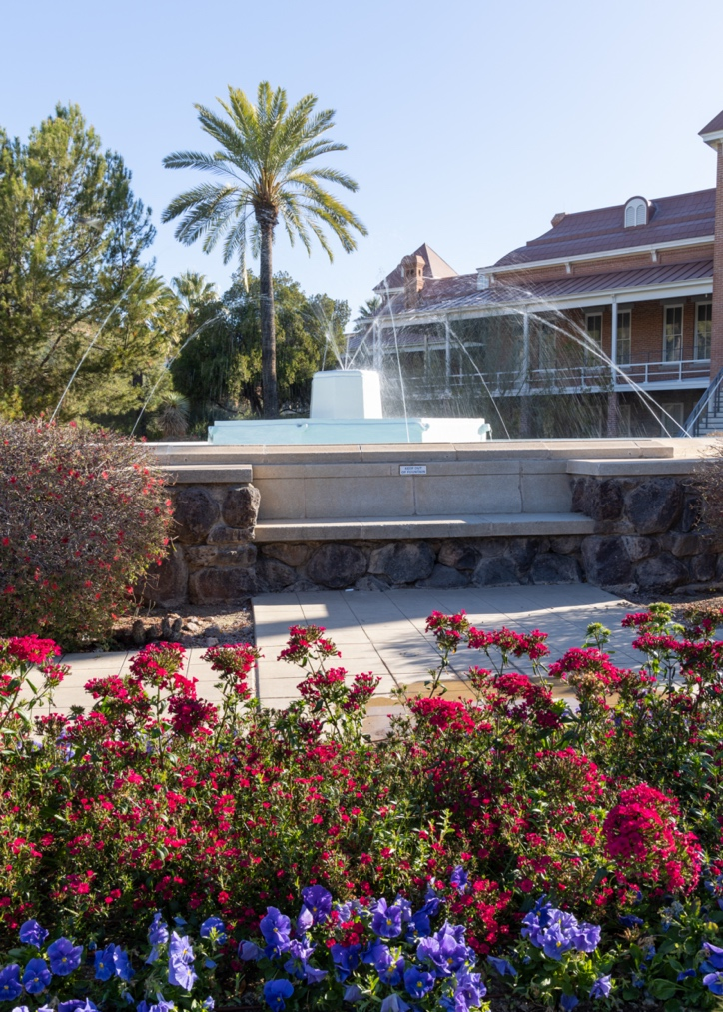
Case Summary
Identify any existing or needed health or community-based services:
Healthcare Services: Eligibility / Enrollment / Contact Information
The 12-year-old daughter has recently been exposed to TB recently at a friend’s house and is not allowed to return to school until she can get her a chest x-ray.
Community Services: Eligibility / Enrollment / Contact Information
She currently receives support for child daycare for 4-year-old. Other two children attend school. Will need help with childcare.

Slide 13
Overall Assessment
Encounter #1 – Ongoing treatment for stage 4 triple negative breast cancer initially stopped advance of cancer. Nausea, vomiting and diarrhea from oral capecitabine are managed by medications. Recently Leslie experienced cough and PET scan was ordered. Assessment finds right lung clear to auscultation and left lung dim. Leslie seeking TB skin test and cough syrup. Unaware of results of PET scan.
Encounter #2 - Metastasis of left breast cancer, TNBC, to left lung. IV chemotherapy treatments available however will further reduce quality of life and only increase life expectancy by 6 months at most. Prognosis poor. Recommend palliative care to start making decisions for herself and children.

Slide 14
Advance Care Planning
Encounter #1 – She has not even considered that she might need a living will or advance directives because breast cancer is curable when caught early. Her cancer was discovered early on a mammogram that she had every year, just like her doctor told her to.
Encounter #2 – She doesn’t know where to start because there is no one that she can think of that would take all 3 of her children and she doesn’t want them split up. She is going to try alternative treatments such as nutrition therapy, and ozone therapy that will slow down the cancer.
If she can just stay alive for at least 4-5 years, to see her older child graduate from high school, then they will be on their own. Her daughter will be old enough to take care of the other children.

Slide 15
Advance Care Planning
Advance Care Planning
What matters most to the Leslie now?
Encounter #1 – Fighting the cancer and doing whatever it takes to be cured from it. If she could just have more energy and stop vomiting.
Encounter #2 - Spending quality time with her children and not have them think of her as “sick.” She wants to be able to get up in the morning and make them breakfast and walk them to the school bus stop and daycare center.
What do they want for their health?
Encounter #1 – To stay strong enough to fight the cancer.
Encounter #2 - To be able to at least see her oldest daughter graduate from high school.

Slide 16
Next Steps / Outcomes
What happens next: Who can help her with shared decision making for determining level of aggressiveness of treatments? What is most important at each setting? How do you determine what matters most to the patient/family and goals of care? Quality or quantity decisions need to be made.
Details about family conversations:
What happens at, or near, death of patient:
What support does family need before and after death of patient:
• Family members have a conversation about end-of-life (EOL) wishes and desires. Leslie doesn’t want to talk about EOL.
• Healthcare Services Resources
• Community Services Resources
• Spiritual Health/Counseling

Slide 17
Challenging Conversations
Best Case / Worst Case:
Risk / Benefit of Intervention:

Slide 18
Interprofessional Focus
What role do other disciplines play in this patient’s end-of-life care?
Spiritual Health/Counseling, Pharmacy, Nursing, Social work
Who can help you provide the best care and honor the patient’s wishes?

Slide 19
Interprofessional Focus
How will you approach utilizing a team approach to providing care?
Beyond referrals, how will you become comfortable with going outside your comfort zone?
Are there any integrative, traditional, or complementary therapies that will help the patient at this stage or later?

Slide 20
Questions to Consider
?
Can you identify any overarching bias?
Can you identify any possible assumptions one might make about this patient?
What information about this patient might inform public policy or regulatory action?

Slide 21
Teaching Points
Check boxes to indicate 3-5 teaching points:
x
ADVANCE CARE DIRECTIVE
Teaching point: Each health science student should be
knowledgeable about advance care directives; and
be able to communicate and engage patients / families in advance care planning across settings and across the lifespan.
x
PALLIATIVE CARE AND HOSPICE
Teaching point: Each health science student should be
knowledgeable about palliative care and hospice; and
be able to effectively communicate this information to patients / families.

Slide 22
Teaching Points
Teaching Points
Check boxes to indicate 3-5 teaching points:
x
CULTURAL HUMILITY
Teaching point: Each health science student should be
knowledgeable about cultural considerations in the care of patients and families, and
be able to effectively communicate with humility, curiosity, care, respect, and dignity.
x
COMMUNITY RESOURCES
Teaching point: Each health science student should be
knowledgeable about community resources to support serious illness and end-of-life care, and
be able to effectively connect patients/families with these resources.

Slide 23
Teaching Points
Check boxes to indicate 3-5 teaching points:
x
CHALLENGING CONVERSATIONS
Teaching point: Each health science student should be
knowledgeable about how to deliver “best case / worst case” and
be able to effectively conduct challenging conversations with patients / families (including how to discuss risk / benefits of interventions).
x
INTERPROFESSIONAL CARE
Teaching point: Each health science student should be
knowledgeable about the role of team members & benefits of team-based care and
be able to effectively work with team members in the care of patients / families with serious illness or at the end of life.

Slide 24
Resources
Susan G. Komen https://www.komen.org/
Center for Rural Health Resources www.crh.arizona.edu
American Cancer Society https://www.cancer.org
List of Arizona's Critical Access Hospitals https://crh.arizona.edu/programs/flex/cahs
List of Arizona's Rural Health Clinics https://crh.arizona.edu/programs/flex/rhcs-list
Arizona Rural Safety Net Map https://crh.arizona.edu/map-room
List of all Federally Qualified Community Health Centers https://www.aachc.org/communityhealthcenters/map/
Arizona Oncology Foundation www.arizonaoncologyfoundation.org
https://www.cancer.net/sites/cancer.net/files/advanced_cancer_care_planning.pdf

Slide 25
Resources
Clinica Amistad
https://www.clinicaamistad.org - This Clinic operates under a sliding scale model. Means that it may not be free depending on patient income. 110 W Irvington Rd, #3c Tucson, AZ 85714 520-305-5107
Health Insurance
Arizona Center for Rural Health (CRH) Insurance Assistance or visit http://coverarizona.org/connector/ Helpline 1800-3773536
Pima County Housing Resources
Section 8 Program 520-791-4739
Community Food Bank
3000S Country Club Rd, Tucson, AZ 85713- 520-622-0525
Pio Decimo Center Food Bank
848 S 7th Ave, Tucson, AZ 85701- 520-622-2801

Slide 26
Resources
Southern Arizona Legal Aid Inc
Provides free civil legal aid services to low-income individuals and families in Southern and Southeastern Arizona, including 11 of Arizona’s Native American tribes. 2343 E Broadway Blvd, #200 Tucson, Az 85719-520-623-9461
Spiritual Support Chaplain Services at St Mary’s Medical Center Counseling and Support
Assists with end-of-life decisions; pray with patient, contact community clergy of faith groups.
St. Elizabeth Health Center-Catholic Community Services
Faith-based community health clinic in Tucson, Az. Serves uninsured and undeserved persons in Southern Arizona. 140 W Speedway Blvd, #100 Tucson, Az 85705
2-1-1 Get Connected Get Answers
877-211-8661 Arizona Supplemental food and nutrition programs. Shelter and housing, utilities assistance, rent assistance.

Slide 27
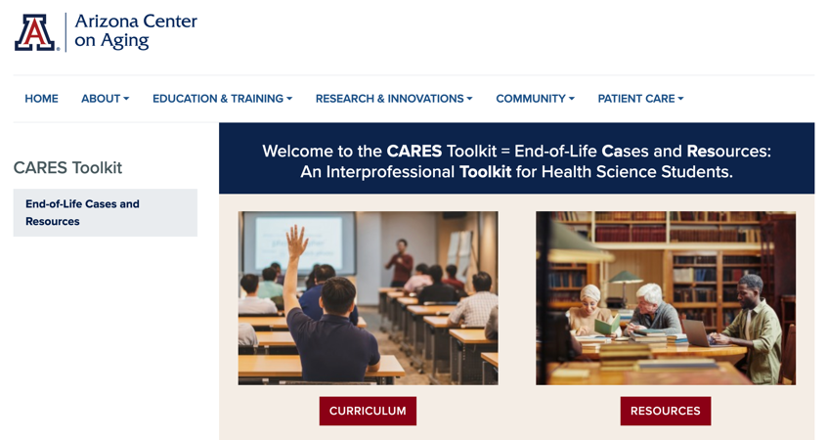
Thank
you
Please visit the Center on Aging
aging.arizona.edu
for more information on the CARES Toolkit
and other end-of-life resources
This project was funded by a grant from the David and Lura Lovell Foundation

