Slide 1
The CARES Toolkit
End-of-Life Cases and Resources:
An Interprofessional Toolkit for Health Science Students
Case Name: 14-Year-Old Latina Girl Living with Bone Cancer
College:
Course:
Instructor:

Slide 2
Learning Topics
1. Build healthy public policy
2. Create supportive environments
3. Strengthen community action
4. Develop personal skills
5. Reorient health services

Slide 3
Specific Communication / Conversation Skills
Listening
Conciseness
Body language
Confidence
Open-mindedness
Respect
Using the correct medium

Slide 4
Interprofessional Team Members
Team Members/Role:

Slide 5
Case Summary
Setting of Encounter: Community Health Fair.
Context / Reason for Encounter: Emma and her parents attend an American Cancer Society sponsored Community Health Fair to visit table exhibitors who provide information related to cancer, including community and health resources, caregiving resources, insurance benefits, and policy/advocacy. They approach a College of Public Health table that is manned with 2 public health students.

Slide 6
Demographics
Name: Emma Rodriguez
Gender: Female
Age: 14-years-old
Ethnicity: Latina – Mexican-American or Central American
Living Situation: Emma lives at home (apartment) with her parents and grandfather. Spanish is primary language at home.
Occupation:
Insurance Coverage: Undocumented immigrants without insurance
Family / Caregiver Issues:

Slide 7
Demographics
Social Economic Status: Both parents work - father in construction/mother cleaning houses; Emma goes to public school. Are there resources that can help with finances: living expense, medical bills, time off work? Are there legal resources or community advocates that the family already has relationships with to offer support? What other networks for support are Emma and her family already engaged with that could provide mutual aid (neighbors, community cultural associations, grassroots organizers, churches)?
Social Determinants of Health:
Social / Mental Health Wellbeing: Emma does well at school, interested in math and science, loves soccer. Is she maintaining contact with friends? Continued socialization is important. What coming of age celebrations or rights of passage may Emma be missing out because of diagnosis or treatment (driving license, quinceanera) and how can her medical team respect those traditions and empower her to find adaptive ways to honor her youth while facing her potential end-of-life?
Religious / Spiritual Considerations: Are Emma’s wishes or the family’s religious/spiritual considerations included in a living will or advance care directives?
Cultural Beliefs / Perspectives: Are there any religious or cultural practices important to the parents and/or Emma? Who else needs to be consulted about Emma’s care or health?

Slide 8
Patient Health Information
History of Present Illness: Emma has recently been diagnosed with stage III metastatic osteosarcoma (bone cancer that has spread to other parts of the body). She has significant left leg pain. She struggles to walk so the family recently got her a wheelchair to use. She has anxiety and depression related to her diagnosis.
Illness Course / Treatment Information: Diagnosis, discussion of treatment and prognosis and finally discussing failure of treatment and palliative medicine/hospice. Sometimes when parents are undocumented there is fear/anger that options being presented are being limited because of parents’ status. Provide access to bi-lingual community based social service organizations with trained social workers or promatoras who can assist in the discussion of treatment and prognosis or diagnosis.
Physical Exam: Underweight, but otherwise normal exam
Medications / Treatments: No medications other than acetaminophen and ibuprofen for pain first visit, potentially on chemotherapy during second visit. Foodways are also an important part of the family’s wellness practices. Access to fresh foods and traditional Mexican caldos (soups), traditional medicinal teas and tinctures are made at home from family recipes and an important part of physical and emotional comfort.

Slide 9
Patient Health Information
Allergies / Intolerances: None
Tobacco, Alcohol or Substance Use:
Review of Systems: Does the family need information on housing modifications that can help Emma be safe at home? Trauma associated with migration status can impact the readiness or resistance to signing forms presented in English only or presented without opportunity for discussion. Navigation of any public service and assistance may have been negotiated by Emma previously, ensure that she is also engaged in conversations that may normally have been had with only guardians. Be mindful of trust building before sharing information.
Past Medical History: No significant past medical history
Family History: Diabetes and heart disease runs in family

Slide 10
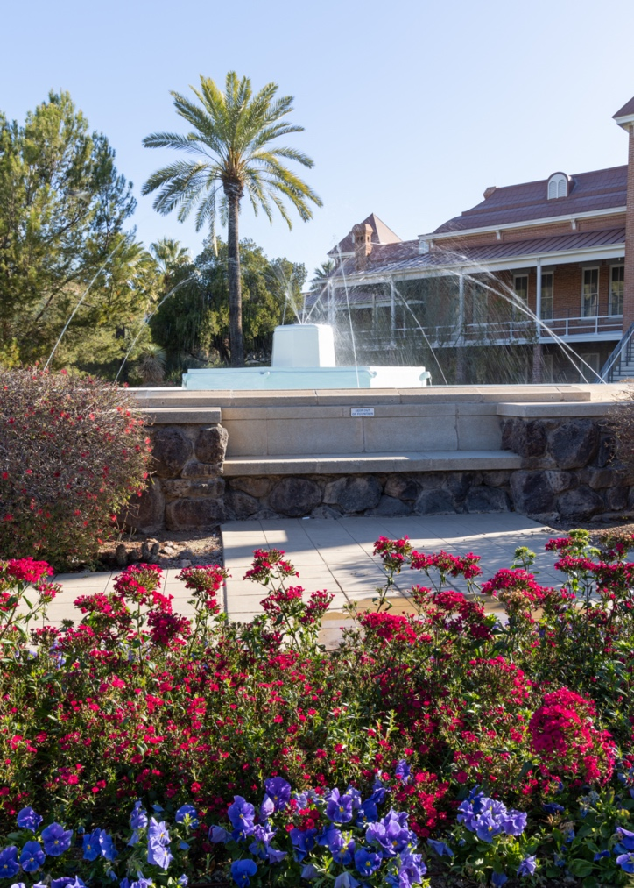
Case Summary
Identify any existing or needed health or community-based services:
Healthcare Services: Eligibility / Enrollment / Contact Information
Community Services: Eligibility / Enrollment / Contact Information

Slide 11
Overall Assessment

Slide 12
Advance Care Planning
Emma does not have advance directives.
What help is needed for the 14-years girl to complete advance directives?
How can we have this conversation with Emma and her family?

Slide 13
Advance Care Planning
Advance Care Planning
What matters most to the patient now?
Emma: She hopes to get better and get back to school, soccer and her friends. Emma is fluent in English and Spanish.
Her parents: Primarily speak Spanish but do have some limited English proficiency. They are both employed, but uninsured. And while they have lived in the U.S. for 10 years, the family is undocumented. They know Emma’s diagnosis is serious and she may not survive. They are interested in learning more about how they might access health care for their daughter. They want to learn more about the cancer, possible treatment plans and what to do if the treatment doesn’t work.

Slide 14
Advance Care Planning
Advance Care Planning
What matters most to the patient now? (Cont.)
Important to know the difference: Palliative care should be offered throughout the entire treatment course - it is NOT an option of last resort, it is woven throughout, to address symptoms caused by treatment, i.e., pain, nausea from chemo/radiation, constipation from opioids, etc. Hospice care is offered at the end-of-life, usually the last 6 months of life and all other treatment care is stopped. The goal is to keep the community member comfortable and pain free until they die. However, in Pediatric cases – a community member can be on hospice at the same time as receiving curative care/therapy.
What do they want their health for?

Slide 15
Next Steps / Outcomes
What happens next: Shared decision making for treatment: surgery/chemo/radiation and eventually decision on palliative care and hospice.
Details about family conversations: Parents concerned about finances and insurance coverage also fearful about their immigration status.
What happens at, or near, death of patient:
What support does family need before and after death of patient:

Slide 16
Challenging Conversations
Best Case / Worst Case:
Risk / Benefit of Intervention:

Slide 17
Interprofessional Focus
What role do other disciplines play in this patient’s end-of-life care?
Pharmacy
Nursing
Social work
Public health
Physician
Who can help you provide the best care and honor the patient’s wishes?
Truth-telling to community member / family may refuse telling community member that treatment is not effective anymore.

Slide 18
Interprofessional Focus
How will you approach utilizing a team approach to providing care?
Beyond referrals, how will you become comfortable with going outside your comfort zone?
Are there any integrative, traditional, or complementary therapies that will help the patient at this stage or later?

Slide 19
Questions to Consider
?
Can you identify any overarching bias?
Can you identify any possible assumptions one might make about this patient?
What information about this patient might inform public policy or regulatory action?

Slide 20
Teaching Points
Check boxes to indicate 3-5 teaching points:
x
ADVANCE CARE DIRECTIVE
Teaching point: Each health science student should be
knowledgeable about advance care directives; and
be able to communicate and engage patients / families in advance care planning across settings and across the lifespan.
x
PALLIATIVE CARE AND HOSPICE
Teaching point: Each health science student should be
knowledgeable about palliative care and hospice; and
be able to effectively communicate this information to patients / families.

Slide 21
Teaching Points
Teaching Points
Check boxes to indicate 3-5 teaching points:
x
CULTURAL HUMILITY
Teaching point: Each health science student should be
knowledgeable about cultural considerations in the care of patients and families, and
be able to effectively communicate with humility, curiosity, care, respect, and dignity.
x
COMMUNITY RESOURCES
Teaching point: Each health science student should be
knowledgeable about community resources to support serious illness and end-of-life care, and
be able to effectively connect patients/families with these resources.

Slide 22
Teaching Points
Check boxes to indicate 3-5 teaching points:
x
CHALLENGING CONVERSATIONS
Teaching point: Each health science student should be
knowledgeable about how to deliver “best case / worst case” and
be able to effectively conduct challenging conversations with patients / families (including how to discuss risk / benefits of interventions).
x
INTERPROFESSIONAL CARE
Teaching point: Each health science student should be
knowledgeable about the role of team members & benefits of team-based care and
be able to effectively work with team members in the care of patients / families with serious illness or at the end of life.

Slide 23
Resources
Cancer Resources
Childhood Cancer Resources https://www.cancer.net/navigating-cancer-care/children/childhood-cancer-resources
End of Life and palliative care for children, teenagers and young adults https://www.betterhealth.vic.gov.au/health/servicesandsupport/palliative-care-for-children-and-young-people
National Cancer Institute - Legislative Activities https://www.cancer.gov/about-nci/legislative/recent-public-laws
Raising Arizona Kids - Pediatric/young adult cancer resources
https://www.raisingarizonakids.com/pediatricyoung-adult-cancer-resources/
Candlelighters - Childhood Cancer Foundation of Southern Arizona
https://www.candlelightersaz.org/
Amanda's Connections - resources for childhood cancer
https://www.amandahope.org/resources
Tucson Cancer Conquerors https://tucsoncancerconquerors.org/
Cancer Support Community Arizona https://cscaz.org/
American Cancer Society Arizona https://www.cancer.org/about-us/local/arizona.html

Slide 24
Resources
Advance Care Planning
19 Evidence-Based Benefits of Advance Care Planning
https://acpdecisions.org/19-evidence-based-benefits-of-advance-care-planning/
NIHNIA Advance Care Planning: Health Care Directives
https://www.nia.nih.gov/health/advance-care-planning-health-care-directives
CDC: Advance Care Planning: Ensuring Your Wishes Are Known and Honored If You Are Unable to Speak for Yourself https://www.cdc.gov/aging/pdf/advanced-care-planning-critical-issue-brief.pdf
Family Caregiving
National Alliance for Caregiving: Cancer Caregiving in the U.S.
https://www.caregiving.org/wp-content/uploads/2020/05/CancerCaregivingReport_FINAL_June-17-2016.pdf
Arizona Caregiving Coalition (support groups and respite resource)
https://azcaregiver.org/
Interpreter Resources
UA College of Humanities National Center for Interpretation - Hire Interpreters for an event https://nci.arizona.edu/hire-interpreter
Translators USA
Tucson https://www.translators-usa.com/locations/arizona-az/tucson/

Slide 25
Resources
Immigration Resources
Chicanos Por La Causa Immigration Services in Tucson offers a broad range of low and no-cost services https://cplc.org/hhs/immigration.php
Consulate of Mexico in Tucson https://consulmex.sre.gob.mx/tucson/
*Some Consulates have emergency funds that can help families like Emma's
Arizona Health Care Cost Containment System - Federal Emergency Services
https://www.azahcccs.gov/PlansProviders/FeeForServiceHealthPlans/ProgramsAndPopulations/federalemergencyservices.html
Arizona Health Care Cost Containment System - Federal Emergency Services - Covered Services and Limitations https://www.azahcccs.gov/PlansProviders/Downloads/FFSProviderManual/FFS_Chap18EmergencyServicesProgram.pdf
International Rescue Committee - Tucson
https://www.rescue.org/united-states/tucson-az
Immigration Status and the Marketplace https://www.healthcare.gov/immigrants/immigration-status/
Immigration Protections and Work Permits
https://www.fwd.us/news/immigration-protections/
* Some undocumented immigrants can qualify for a work permit without lawful status. If one parent qualifies for a work permit, the Social Security Administration will issue a Social Security number for tax purposes. They will then be able to use their Social Security number to get regular AHCCCS for Emma.
New York Immigration Law Center - Obtaining Work Related Visa or Work Permit for Undocumented Immigrants
https://www.nyimmigrationlawcenter.com/practice-areas/employment-based-immigrant-visas/obtaining-work-related-visa-or-work-permit-for-undocumented-immigrants/

Slide 26
Resources
Local Resources (Tucson & Pima County)
Tu Nidito - Tu Nidito provides individual and group support and operates on the belief that it is valuable for grieving families to share their stories, memories, experiences and feelings with others who are going through a similar situation. Support resources for the community also include professional workshops, intervention services, phone consultations, referrals, and written resources relating to grieving children and teens, and their families. https://tunidito.org
Beads of Courage- Provides innovative Arts-in-Medicine programs for children coping with serious illness, their families, and the clinicians who care for them. https://beadsofcourage.org
Clínica Amista- Clínica Amistad is a free health clinic that opened in March of 2003 serving Tucson's low-income, uninsured community. The clinic is a project of Amistad y Salud, a non-profit 501 c3 organization. https://www.clinicaamistad.org
For Healthcare Professionals
1) The Road to Readiness: Guiding Families of Children and Adolescents with Serious Illness Toward Meaningful Advance Care Planning Discussions - National Academy of Medicine https://nam.edu/the-road-to-readiness/
2) Pediatric End of Life Care https://www.vitas.com/hospice-and-palliative-care-basics/end-of-life-care-planning/challenges-in-pediatric-end-of-life-care
3) Emergency Medical Treatment & Labor Act (EMTALA) https://www.cms.gov/Regulations-and-Guidance/Legislation/EMTALA https://www.acep.org/life-as-a-physician/ethics--legal/emtala/emtala-fact-sheet/

Slide 27
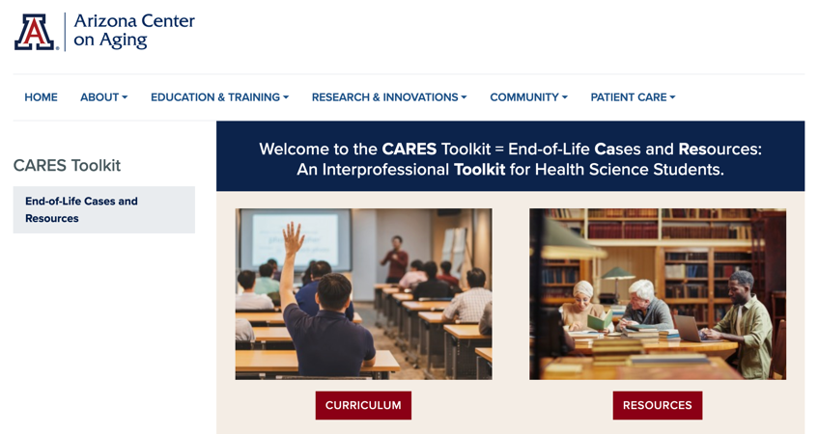
Thank
you
Please visit the Center on Aging
aging.arizona.edu
for more information on the CARES Toolkit
and other end-of-life resources
This project was funded by a grant from the David and Lura Lovell Foundation

